Slide 1
Adaptive Fashion How People with Disabilities Experience Clothing
Susan Rothman Kolko
Lauren Wasser
Richard Phibbs / Trunk Archive

Slide 2
Module 1 The Disability Movement and Adaptive Clothing
Disability Rights Movement
Court Cases
Laws
Rights and Clothing
International symbol of access Susan Koefoed

Slide 3
The Disability Rights Movement
Ed Roberts
Justin Dart
Judy Heumann
World Institute on Disability
American Association of People with Disabilities

Slide 4
Disability Rights Court Cases
Brown v Board of Education 1954
Andrew F. v Douglass Country School District 2017
Mills v Board of Education of District of Colombia 1972
Southeastern Community College v Davis 1974
Olmstead v L.C. 1999
Sutton v United Airlines 1999

Slide 5
Disability Laws
Rehabilitation Act 1973
Americans with Disabilities Act
1975
1973
1990
Individuals with Disabilities Education Act 1975

Slide 6
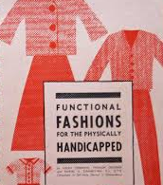
Disability Rights and Clothing
Indistrial Revolution
Helen Cookman
Vera Maxwell
The Speed Suit The Rugby Suit
Functional Fashions for the Physically Handicapped
Levi's
Runway of Dreams
Mindy Scheier

Slide 7
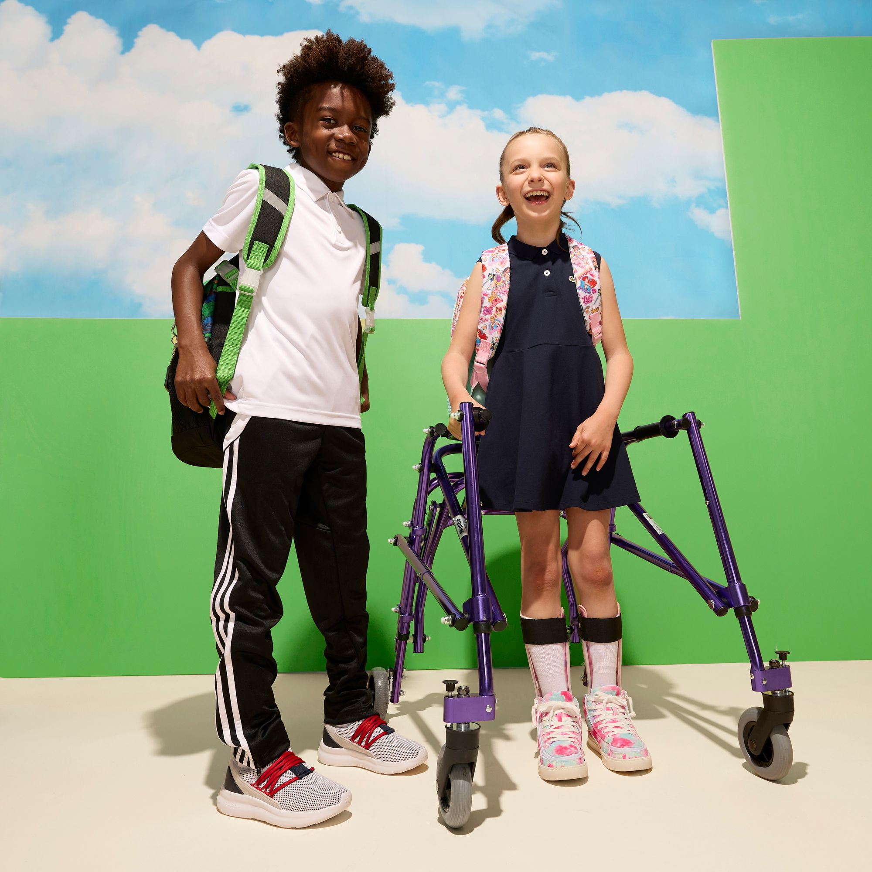
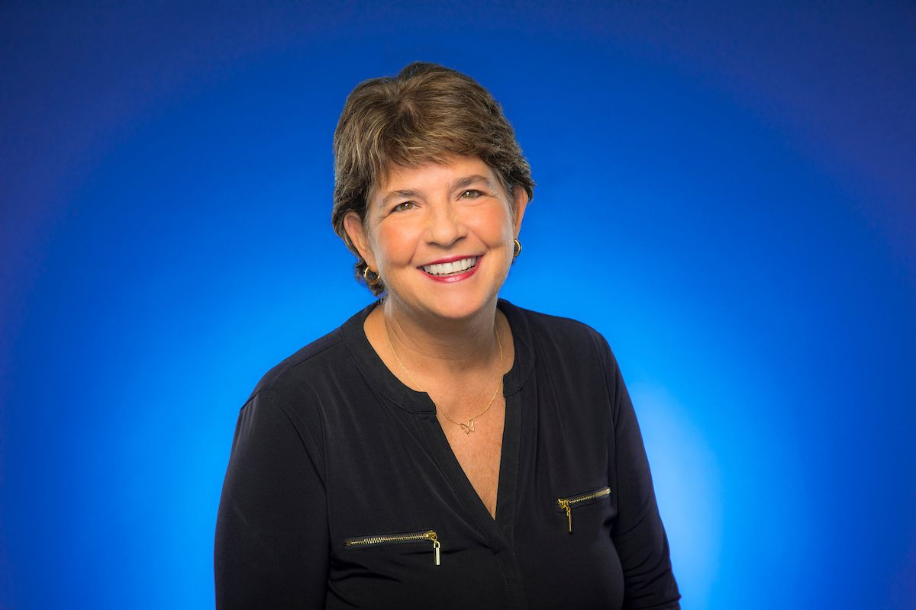
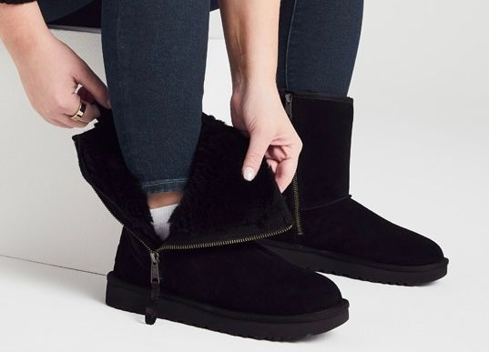
ZAPPOS
Customer service
Satisfying a consumer need
Innovative technology
Accessibility awareness
Affordability
Design technology
Dana Zumba
Business Development
Zappos Adaptive & UGG

Slide 8
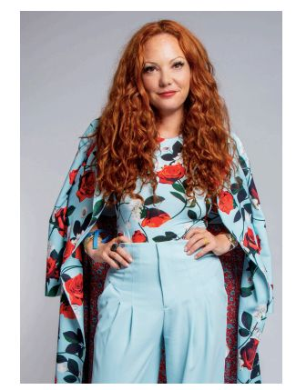
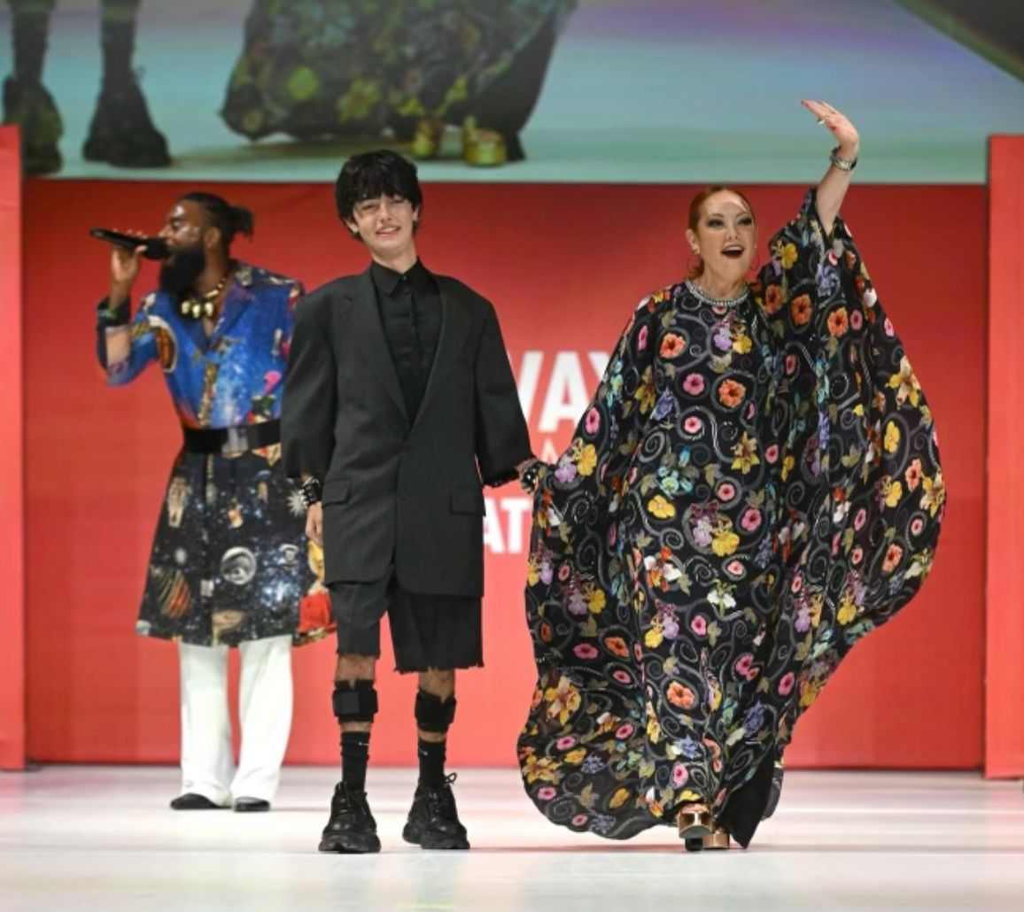
RUNWAY OR DREAMS | GAMUT MGT
Adaptivewear Advocacy
Innovation in Design
Resource for Education
Apparel Industry Entrepreneur
Charitable
Category creator
Fashion designer
Change innovator
Empowerment
Non-profit

Slide 9
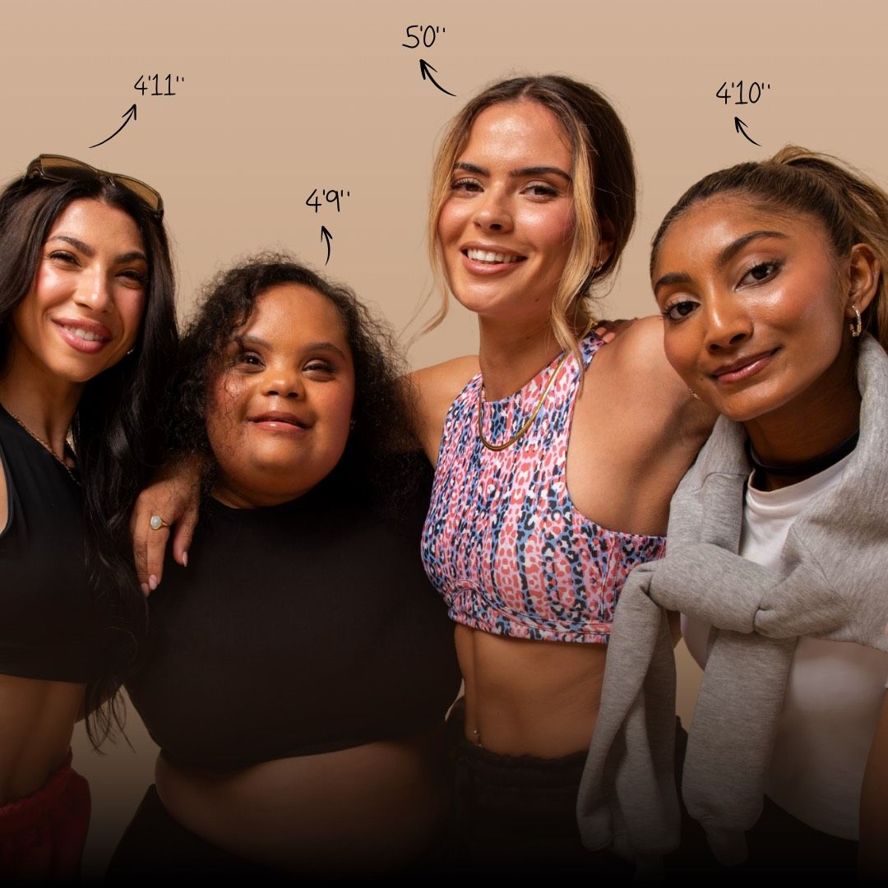
Module 2 Defining the Adaptive Market
The market, fashion and disability
Typical product attributes
Market Research
DEWEY Clothing

Slide 10
Demographic Data on Disability
5% of children under the age of 14 have a moderate to severe disability
40% of adults aged 65 or older report having a disability
Women have more disabling conditions than men
Regions with lower incomes have higher rates of disability
In the U.S., the labor force consists of 20% people with disabilities
Mobility impairments are the most common
People with disabilities are less likely to receive an education
People with disabilities tend to have short life expectancies

Slide 11
Psychographic Data on Disability
want to be independent
are very health conscious
value community support
appreciate disability activists
value accessibility, diversity, equal rights
do not like to feel alone
struggle with mental health and esteem issues
desire to work and be creative
obtaining higher education can be challenging
find that working remotely is agreeable

Slide 12
Behavioristic Data on Disability
have accessibility challenges
have sizing challenges
are brand loyal
enjoy outdoors
prefer online shopping
are interested in the latest technology
are concerned about safety
participate in sports
are concerned about health and tracking health
are concerned about costs and budget
prefer brands and retailers that are inclusive
enjoy gaming

Slide 13
Geographic Data on Disability
wealthier nations have lower rates of disability (Europe and N. America)
poorer nations have higher rates of disability (South Asia and third world Africa)
Latin America and the Caribbean 12% of the population has a disability
Urban areas report higher rates of disability
In lower income areas children with disabilities have a higher rate of not attending school
Employment varies by region but, lower income nations have higher rates of disability
higher income countries can provide more access to transportation, education, employment, and support
Rural areas report lower rates of disability
Culture varies by region and the values that are attached to culture directly affect people with disabilities
Higher income regions have more laws, policies and legislation that supports people with disabilities

Slide 14
Income Data on Disability
poverty rate is higher for people with disabilities
have higher cost of living
unemployment rate is higher
lower income nations have a larger gap in earnings for people with disabilities
20% of people with disabilities have jobs
have higher income in nations that have laws and policies in place
employment is more challenging due to lack of skills
employment rate is lower due to lack of education

Slide 15
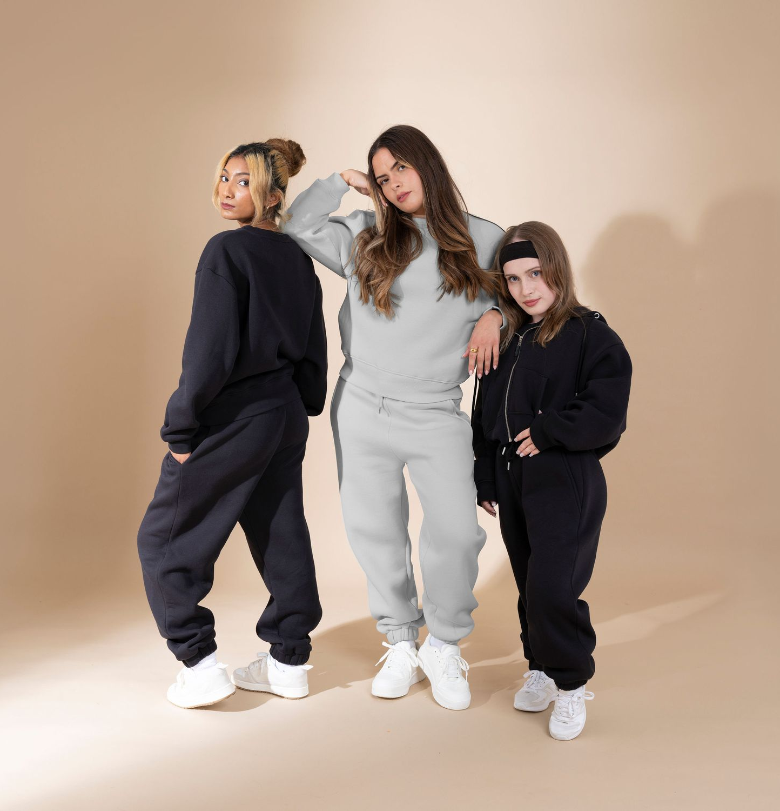
Market Research
Magazines
Fashion forecasters
Stylists
Social Media
Bloggers
Disability advocates
Inclusivity
Technology
Sustainability
DEWEY Clothing

Slide 16
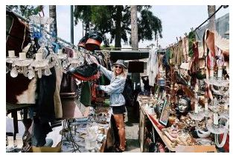
MELROSE TRADING POST
Disability advocacy
Business accessibility
Diversity
Accessibility
Affordability
Accountability
Natalie Iturbe Jackson
Curator & Marketing Manager

Slide 17
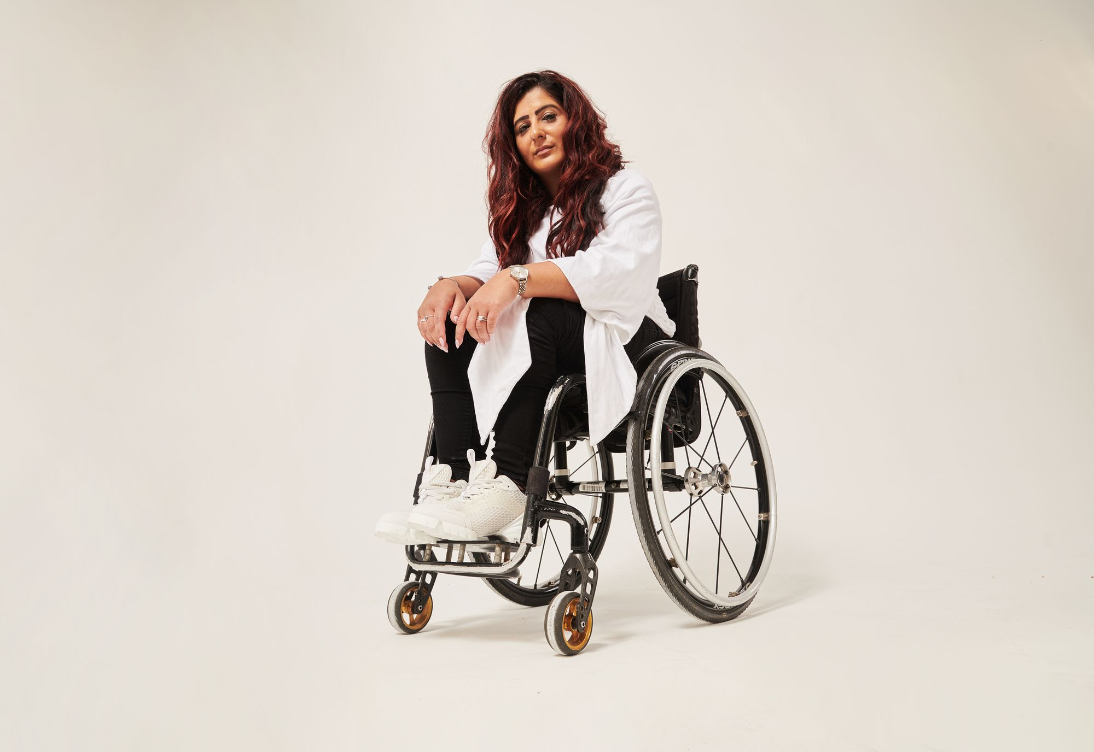
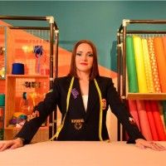
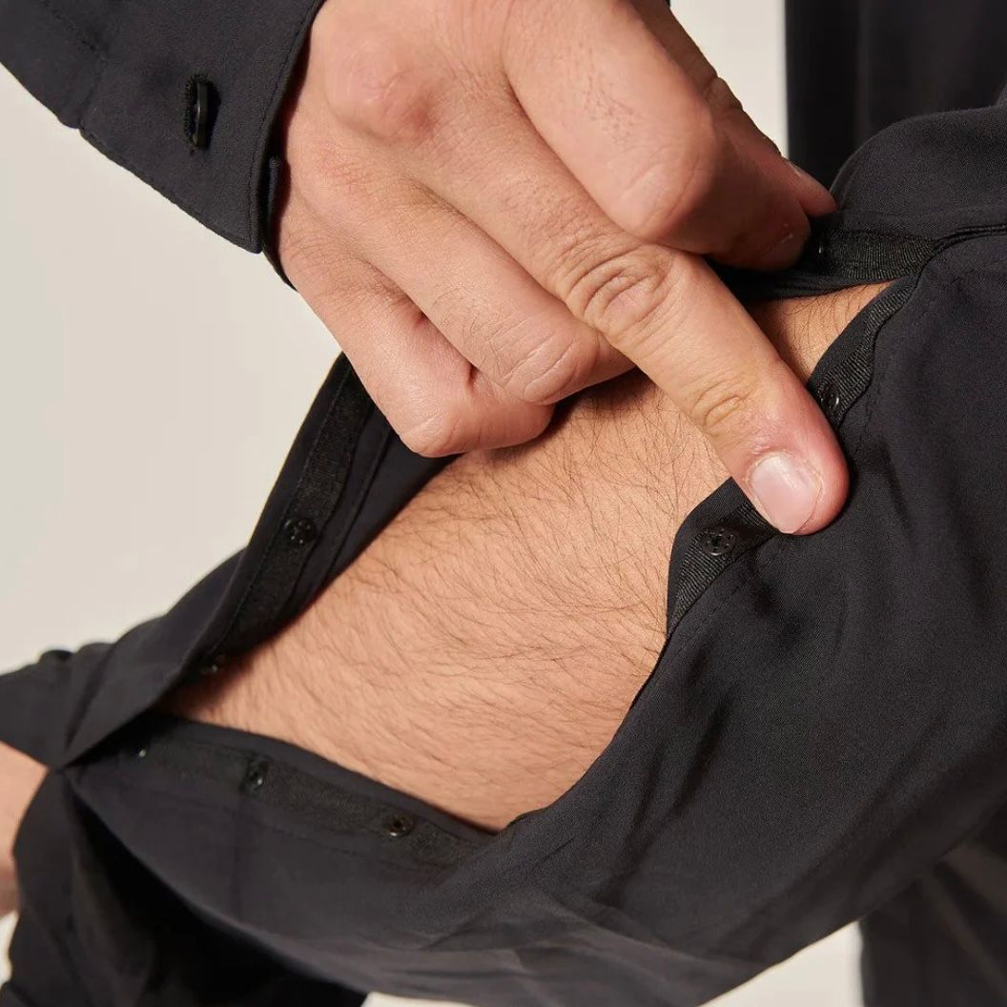
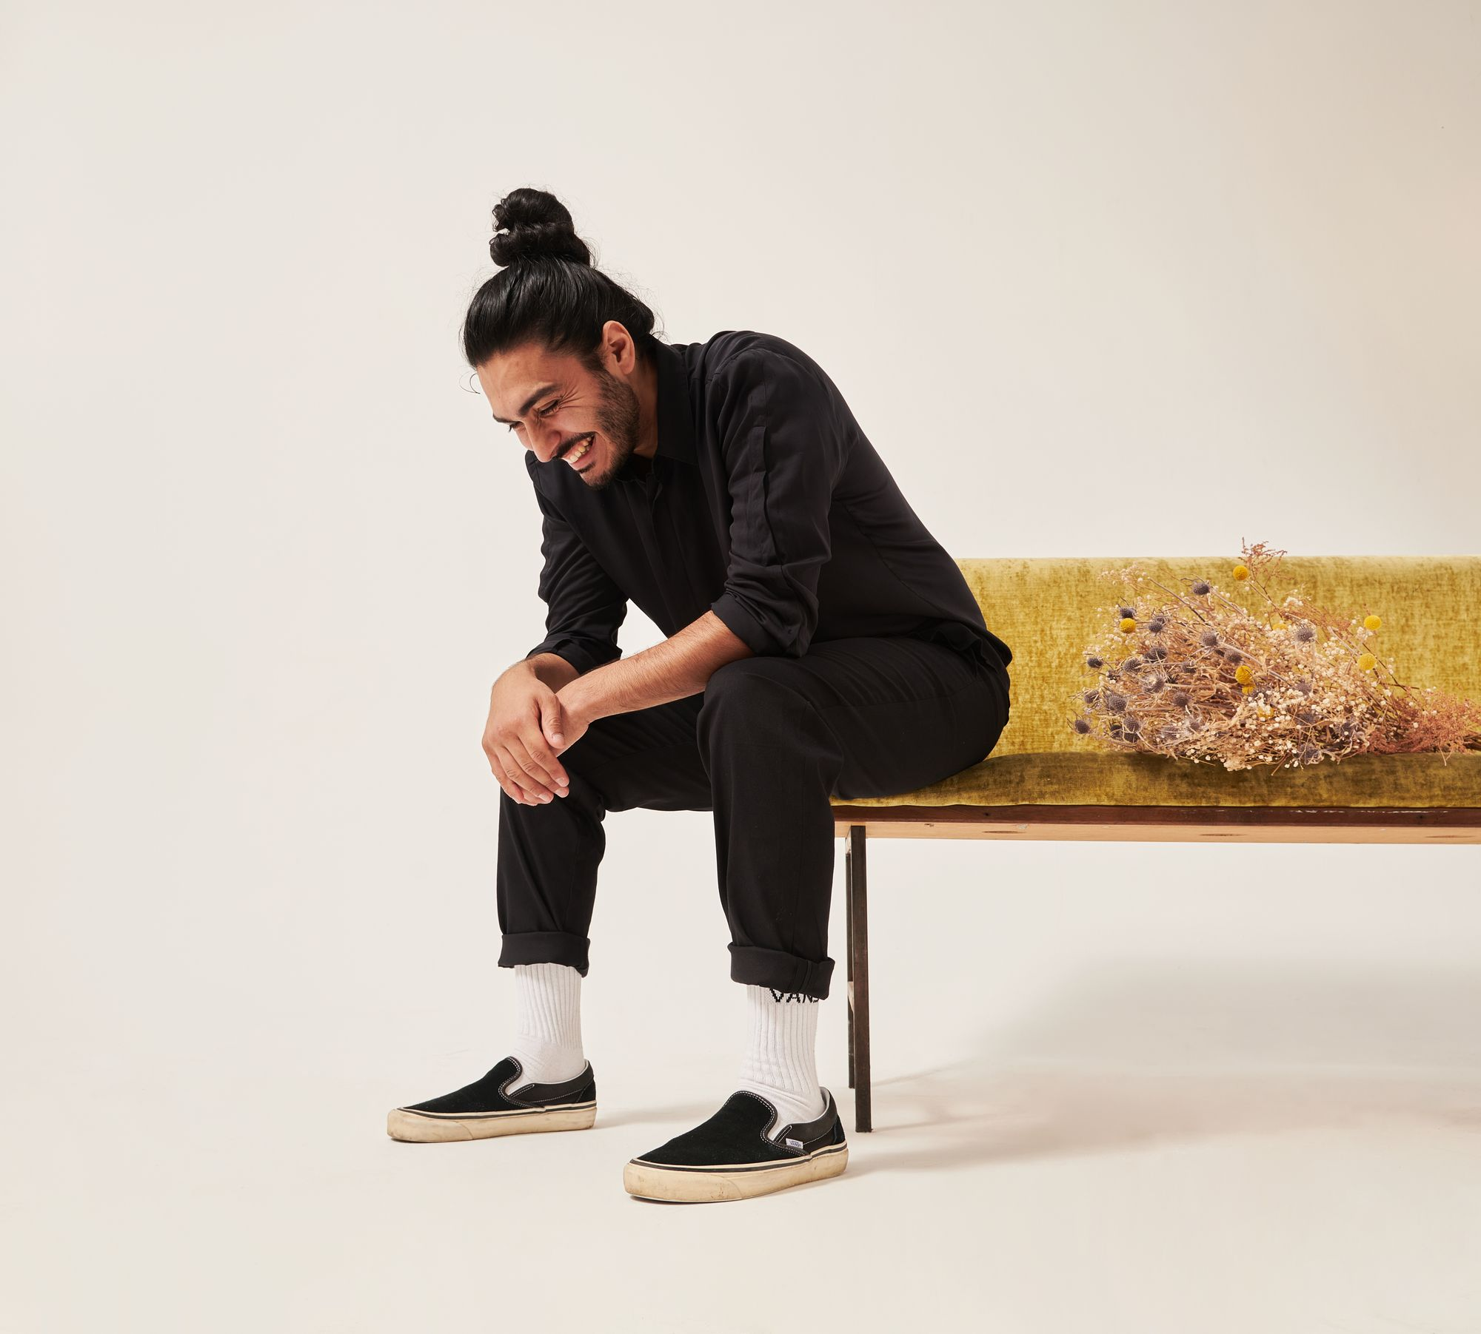
UNHIDDEN
Advanced technology
Branding
Marketing
Consumer sensitivity
Disability advocacy
Business strategy
Global impact
Victoria Jenkins – Founder/CEO

Slide 18
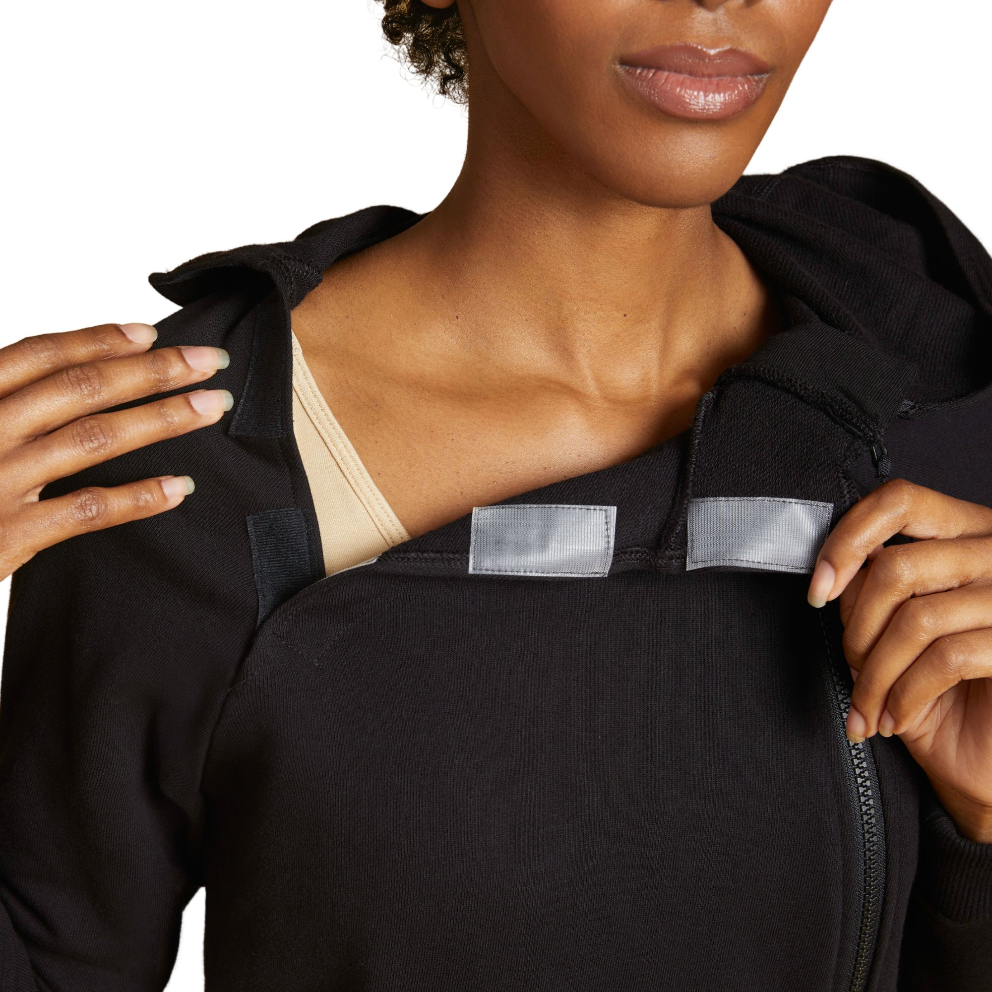
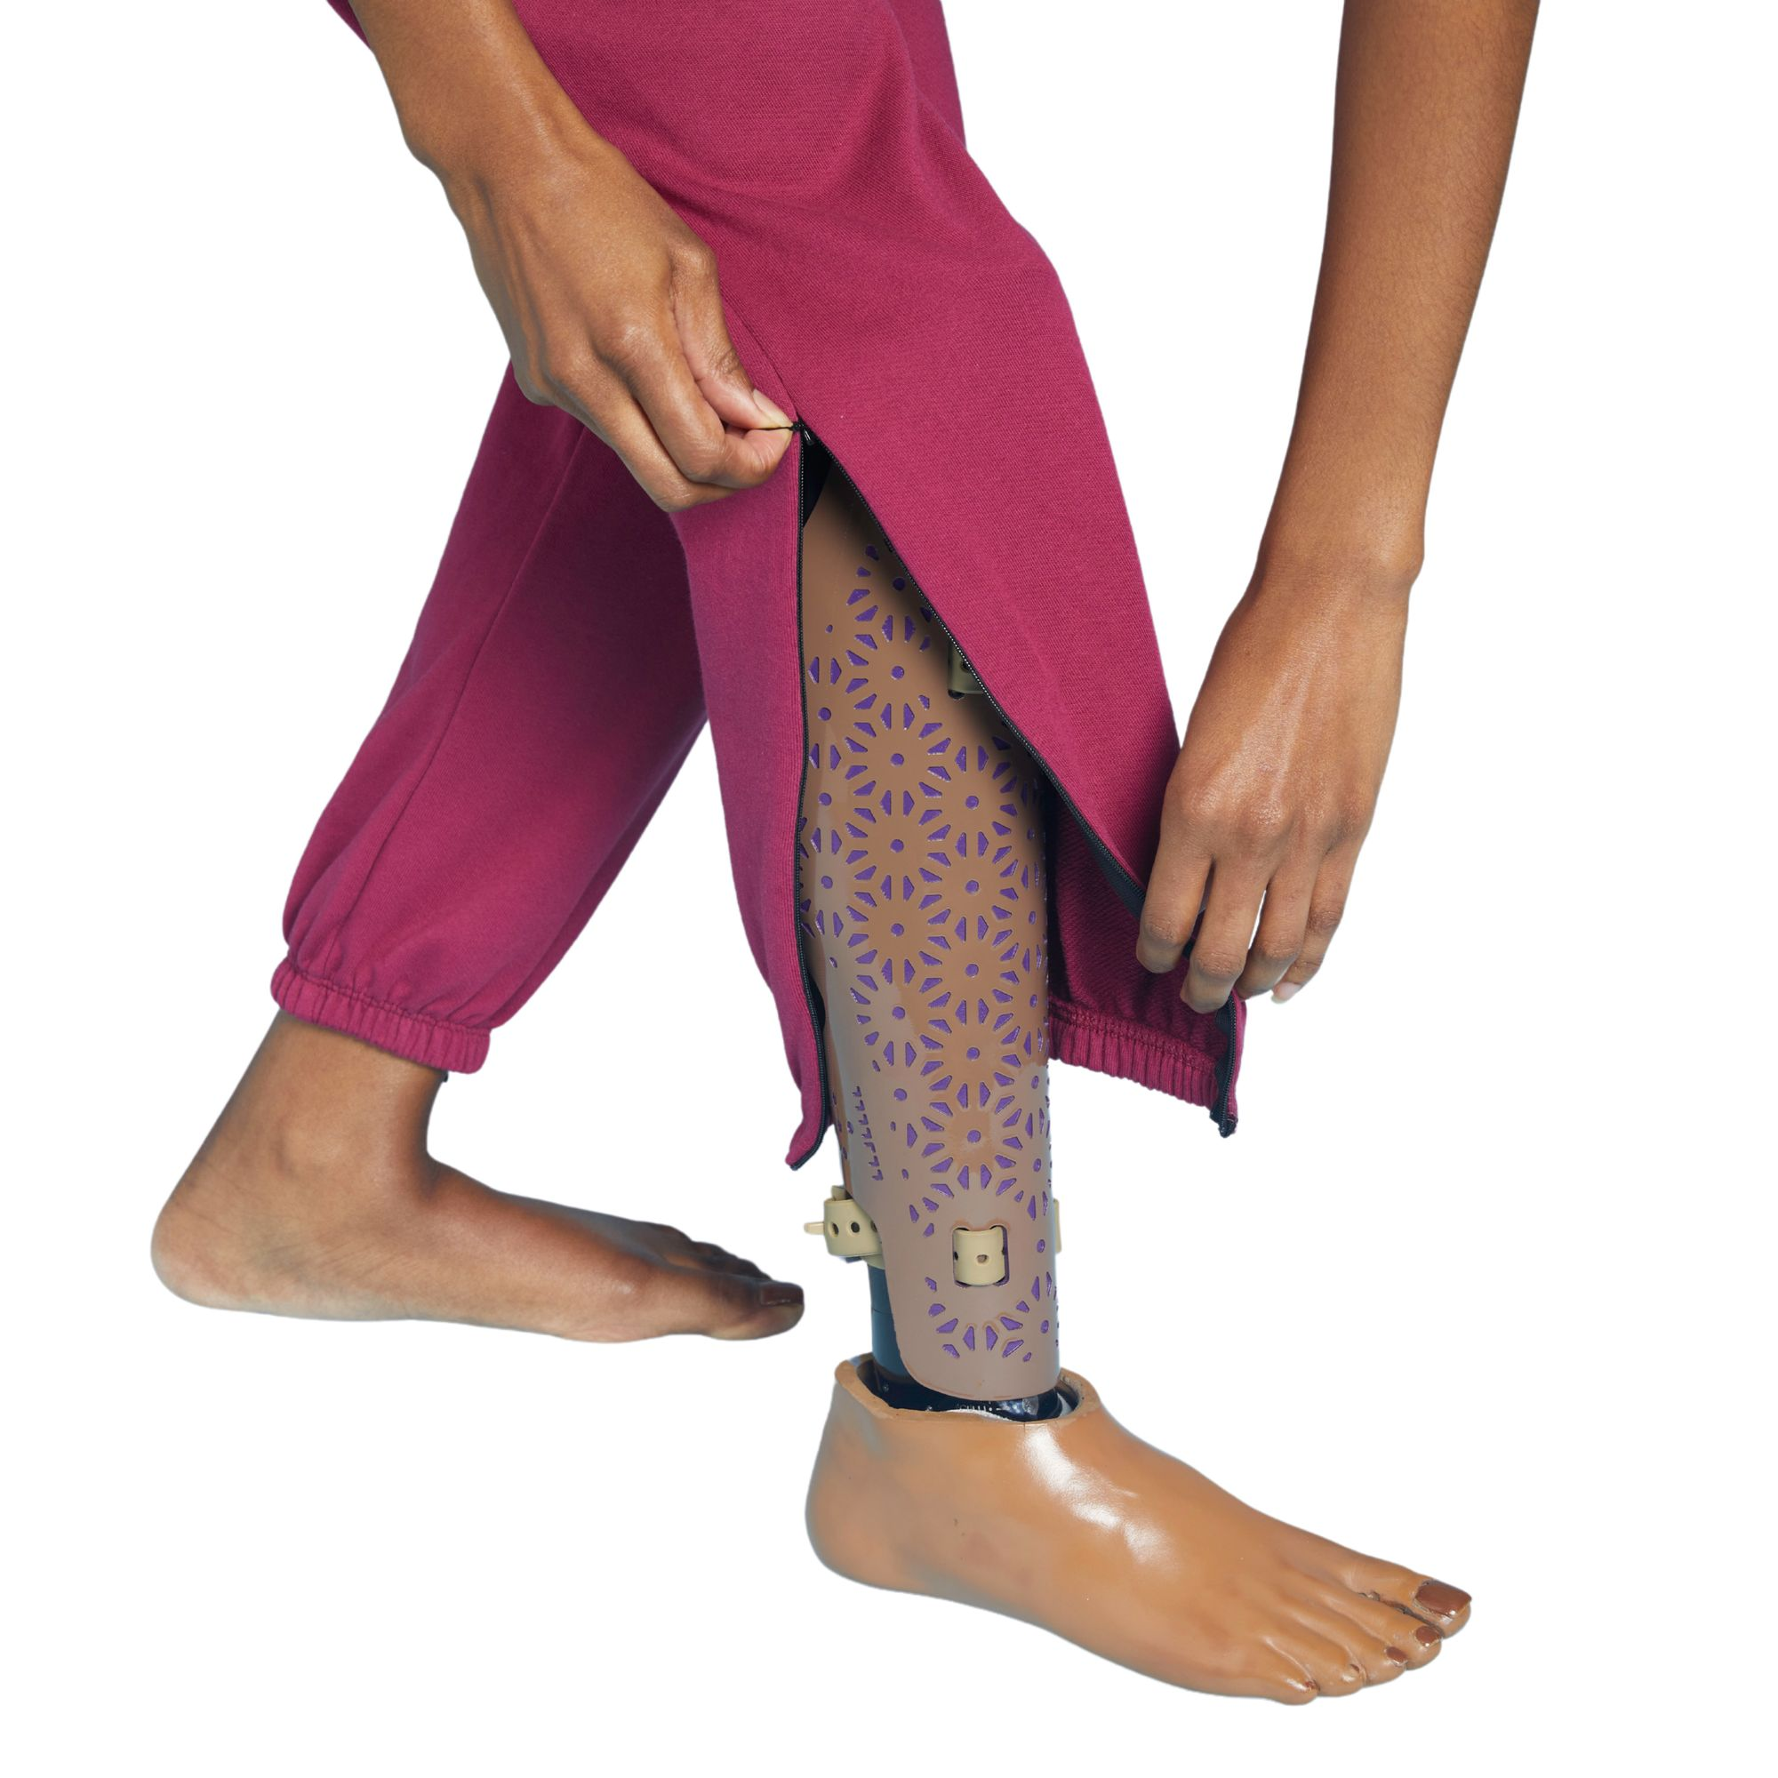
SLICK CHICKS
Category specialist
Accessibility
Sustainability
Marketing
Consumer awareness
Design
Velcro
Diversity
Helya Mohammakian
Founder/CEO Slick Chicks

Slide 19
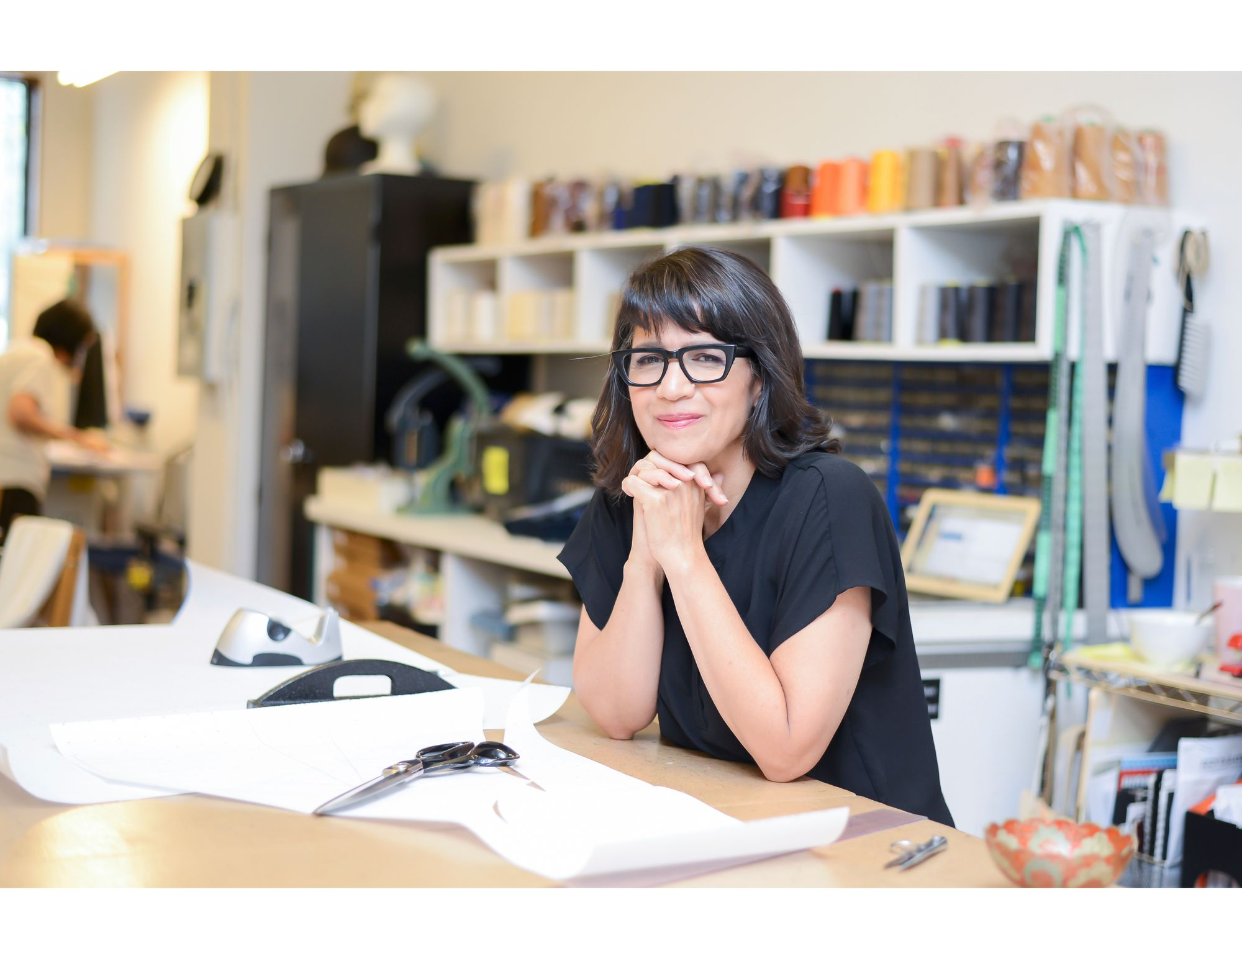
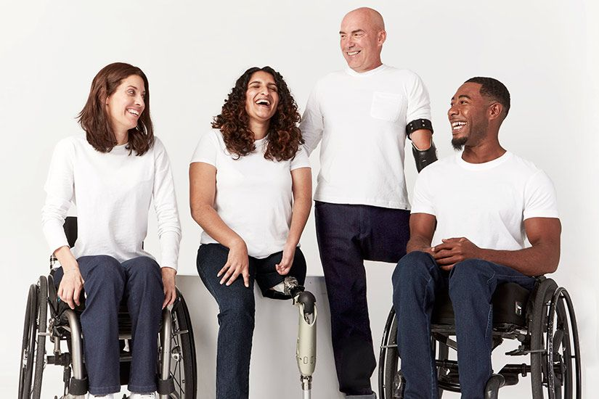
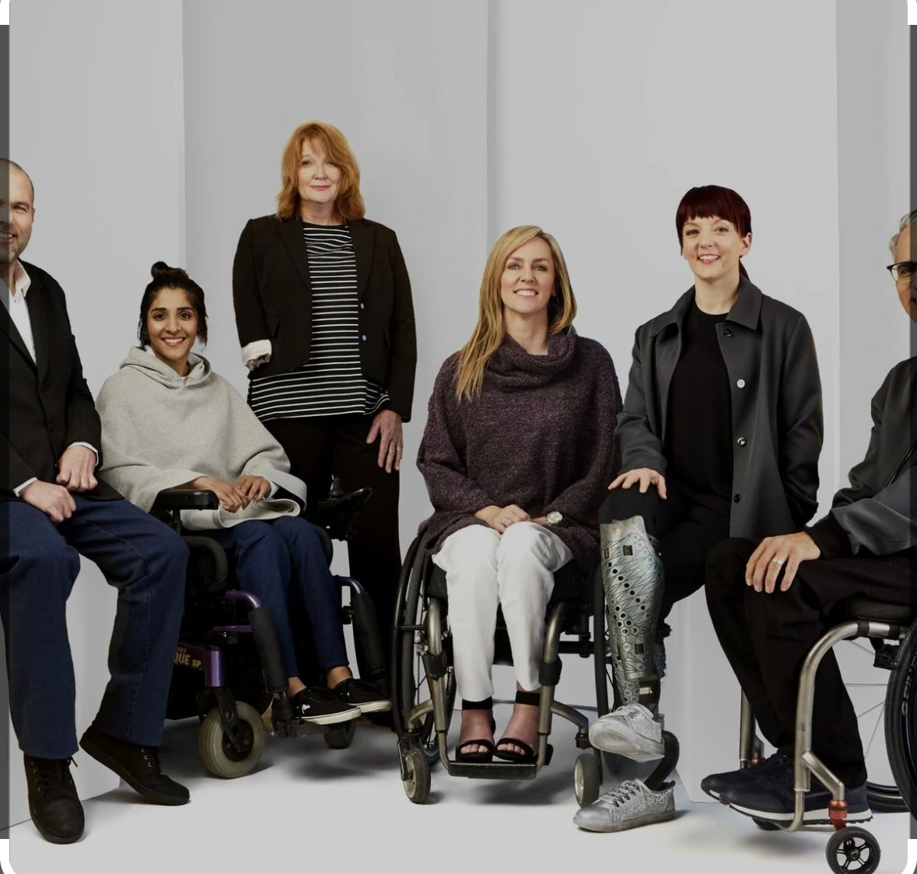
IZ ADAPTIVE
Seamless technology
International
Inclusive design
Branding
Accessibility strategy
Non gender
Design pioneer
Revolutionary
Izzy Camilleri – Founder/ Chief Designer

Slide 20
Module 3 Understanding Disabling Conditions
Three basic groupings
Medical groupings
World Health Organization
U.S. Department of Education
Paralympic Committee groupings
Rolland's three courses of disability

Slide 21
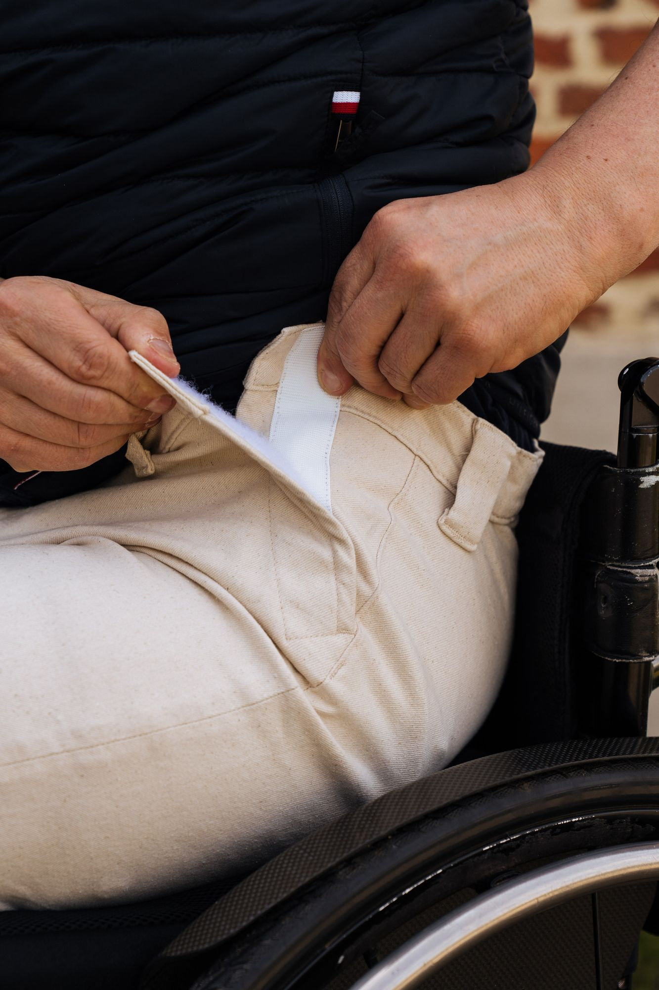
Three Basic Groupings
Physical
Cognitive
Sensory
So Yes

Slide 22
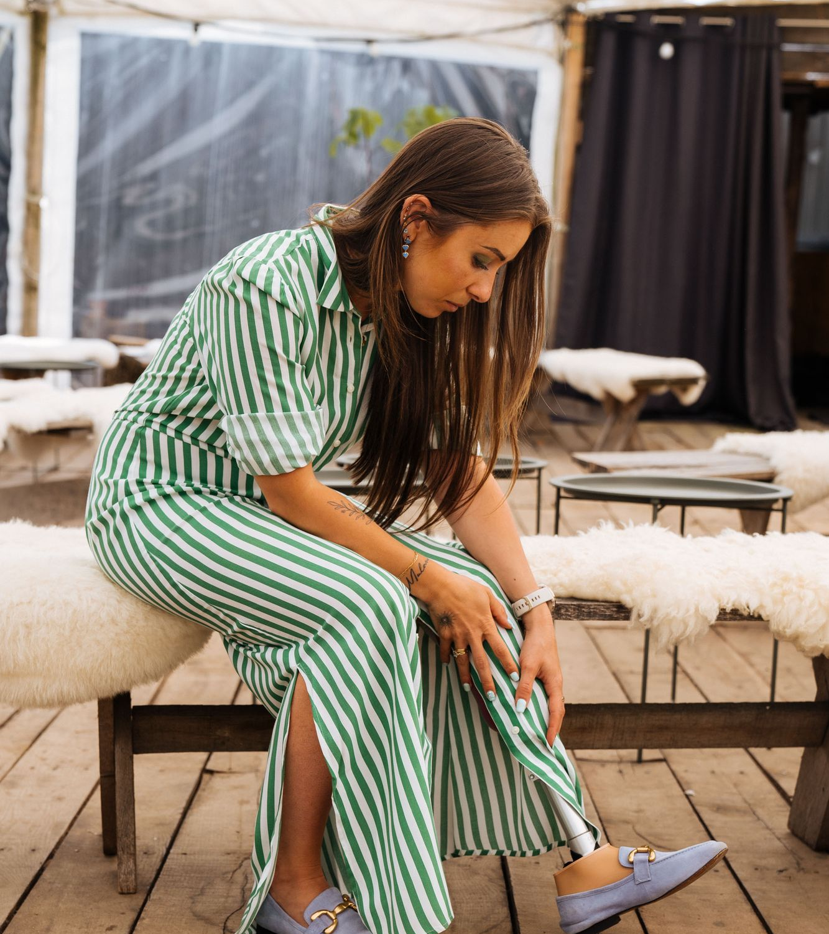
Medical Groupings
Orthopedic impairments
Learning disabilities
Visual and hearing impairments
Paralysis
Deformities
Absence of a limb or other body part
Speech impairments
So Yes

Slide 23
World Health Organization Groupings
Body functions and structure
Tasks and actions by individuals and participation and involvement
Severity and environmental factors

Slide 24
U.S. Department of Education Groupings
Learning disabilities
Autism
Visual impairments
Orthopedic impairments
Traumatic brain injury
Emotional disturbances

Slide 25
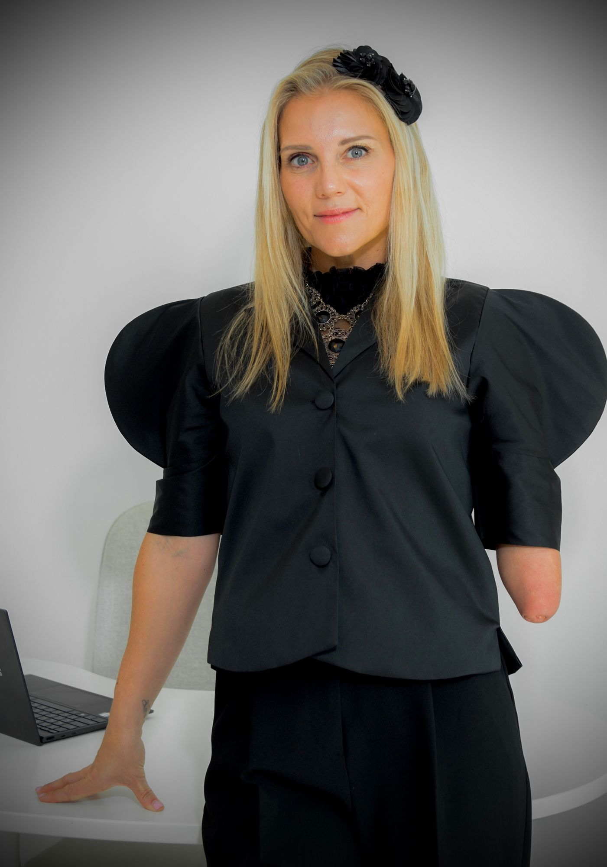
Paralympic Committee Groupings
impaired muscle power, such as from a spinal injury
impaired range of movement, as from arthritis
limb deficiency, total or partial absence of limbs
leg length, the shortening of a bone
short stature
hypertonia, the inability of a muscle to stretch
ataxia, lack of coordination such as in CA and MS
visual impairment
Jessica Smith
Australian Paralympic swimmer

Slide 26
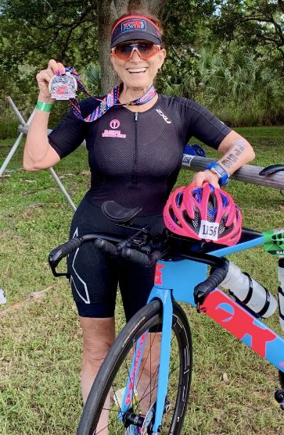
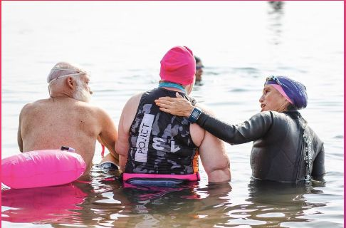
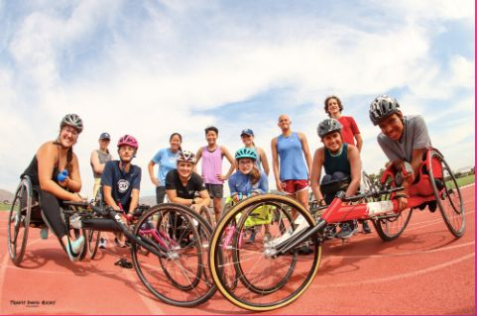
Elevate Multi Sport & Elevate Women 4 Tri
Paratriathlon and cycling
Coaching
Training
Nutrition
Gear
Community
Competition
Inclusion
Diversity
Deborah Carabet
Founder/Coach/Owner

Slide 27
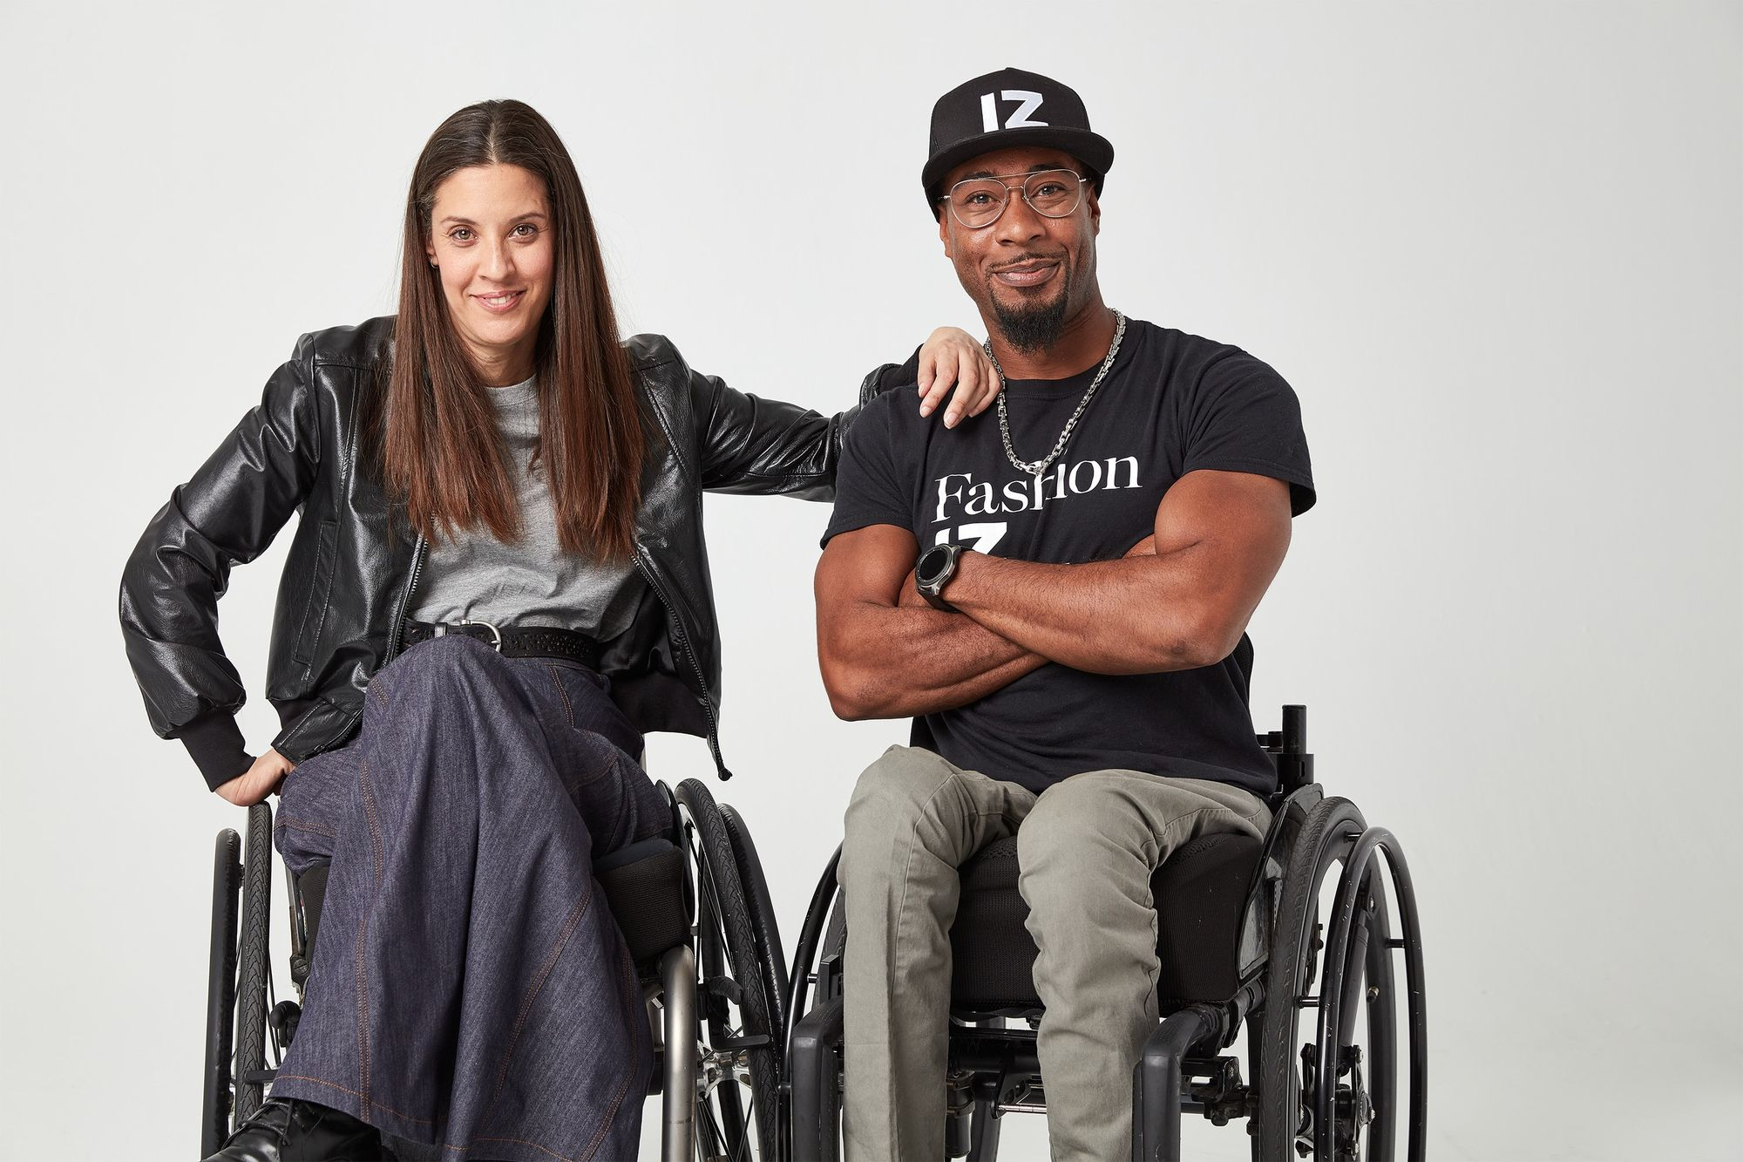
Rolland's Three Categories
Three Courses of Disability
Progressive
Constant
Intermittent or Episodic
IZ Adaptive

Slide 28
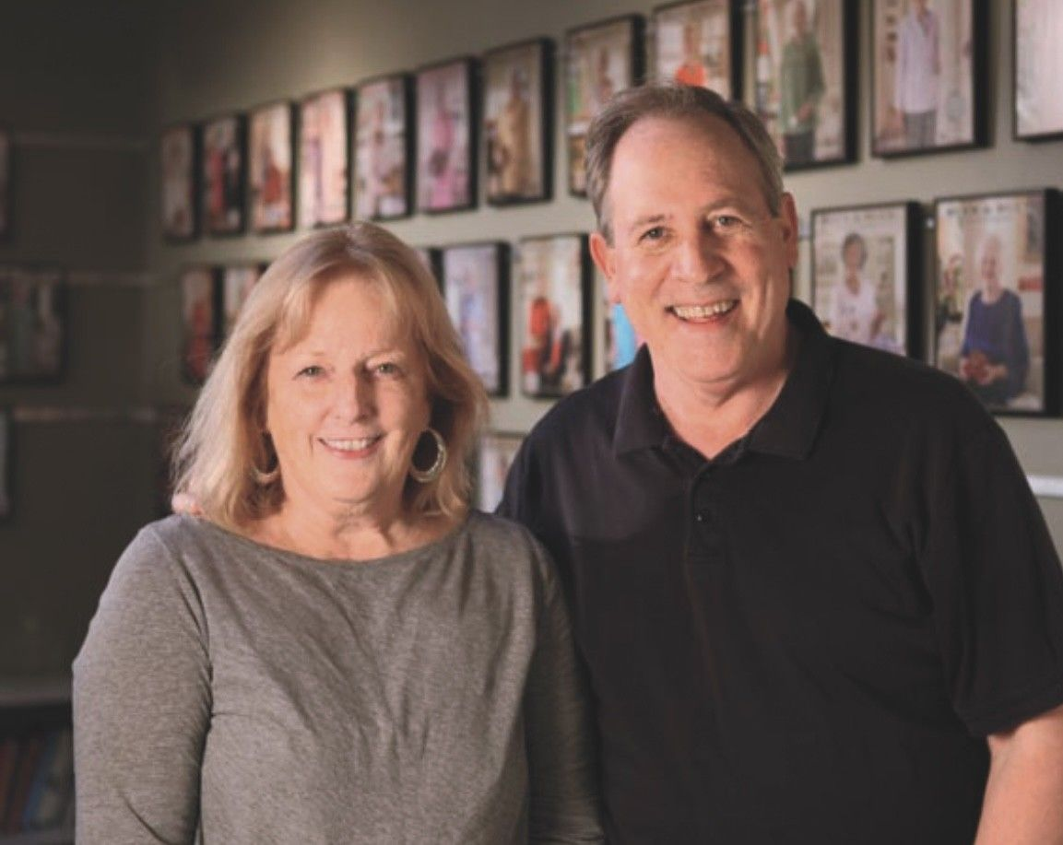
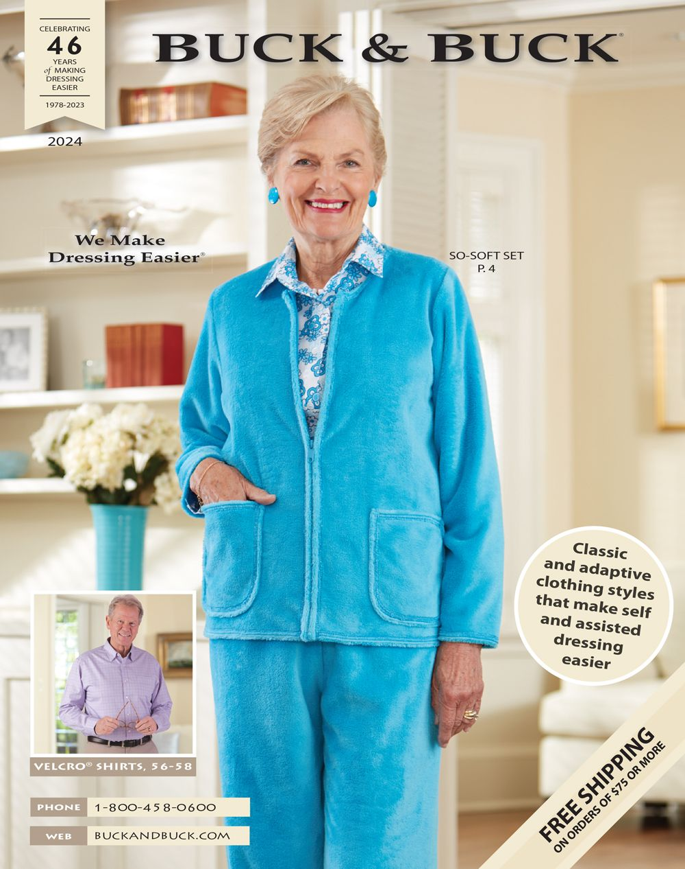
BUCK & BUCK
Seniors
Ease of dressing
Customer service
Made in USA priority
Delivery
Custom orders
On site sewing
Accessible
Affordable
Julie & Bill Buck

Slide 29
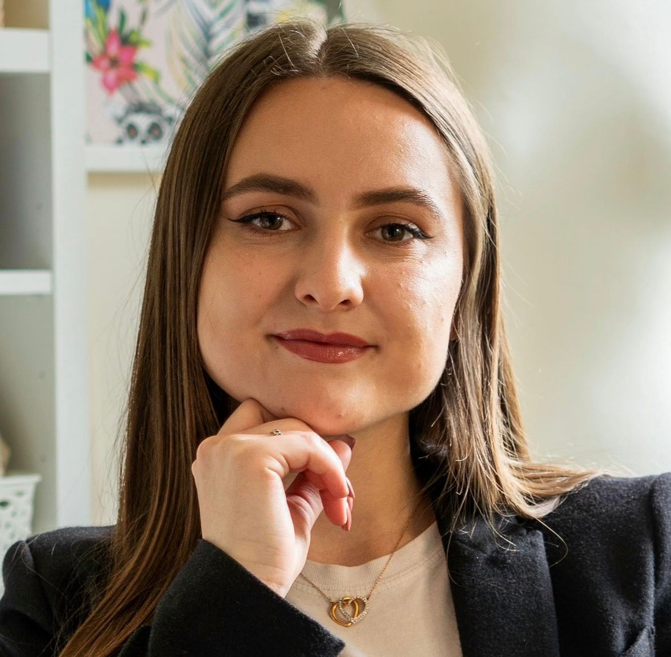
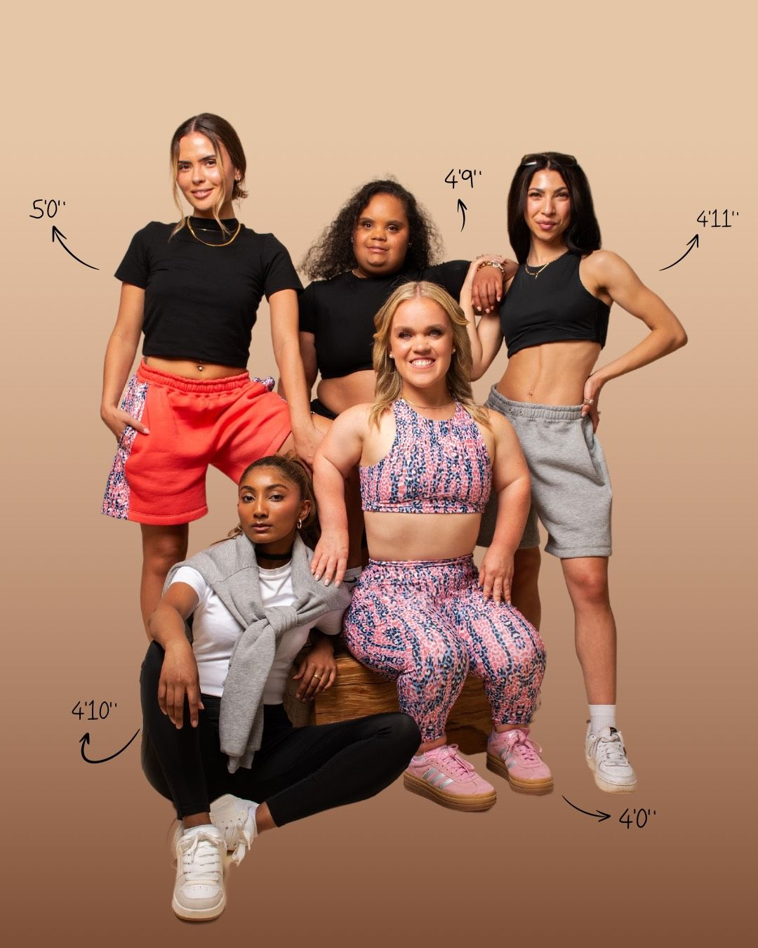
DEWEY Clothing
Inclusivity
Sustainability
Unisex
5 ft and under
Customer service
Community
Design
Chamiah Dewey Founder/CEO
DEWEY Selfridges campaign

Slide 30
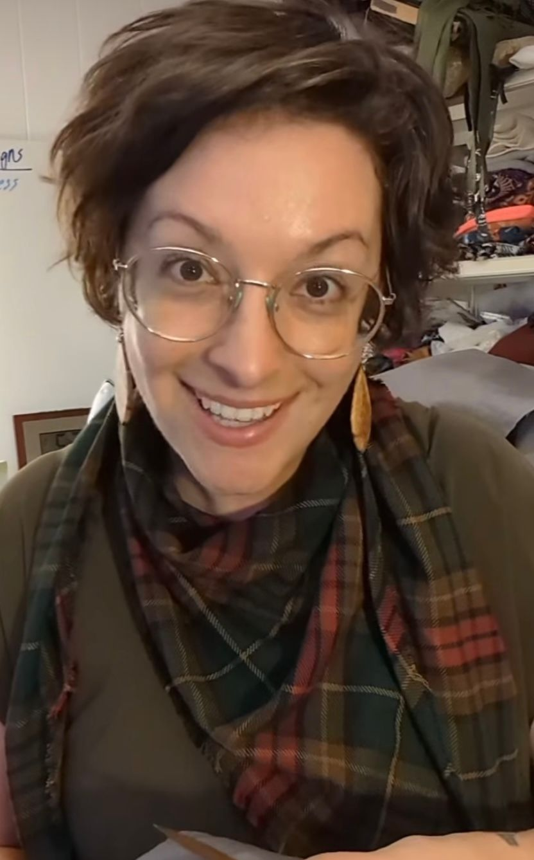
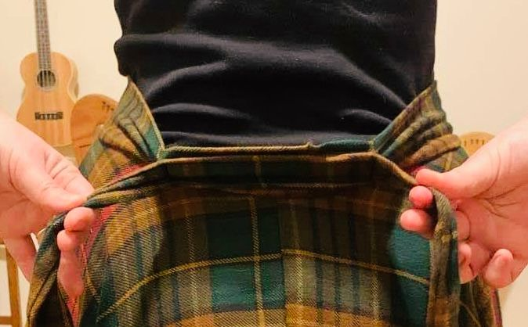
EIGHTFOLD FOX
Comfort
Expressive
Accessible
Ease of use
Creativity
Customer service
Expandable waist
Fox – Founder Eightfold Fox

Slide 31
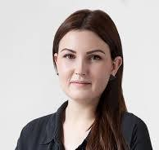
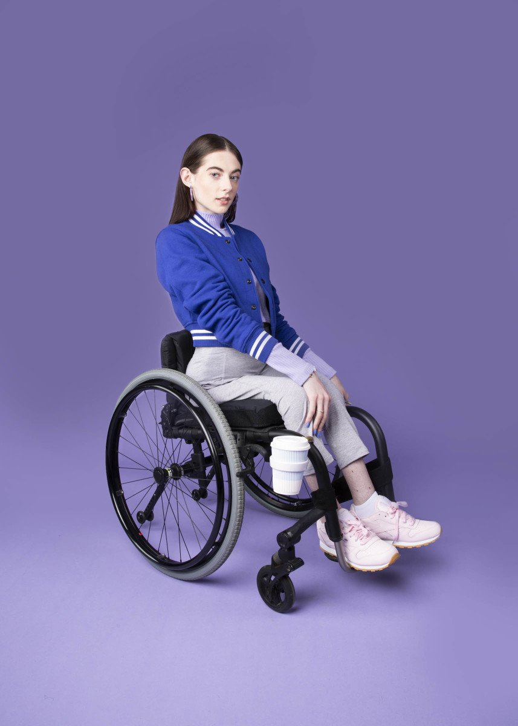
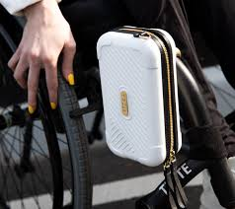
FFORA
Wheelchair attachments
Lifestyle branding
Functional
Accessible
Design
Breaking barriers
FFORA Founder/CEO Lucy Jones

Slide 32
Module 4 Disabilities & Clothing Adaption
Clothing for people
Wheelchairs
Limited dexterity
Access needs
Amputees and braces
Varied bone structure
Visually impaired
Developmental
IZ Adaptive

Slide 33
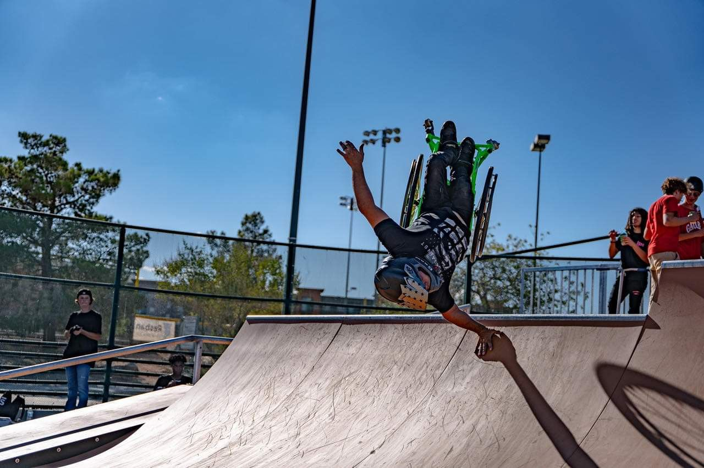
Clothing for People in Wheelchairs
Considerations in design
Extended periods of time in a seated position
Pant proportions must accommodate sitting
Fabrics should be soft, non-binding and moisture wicking
Easy on/off
Comfortable textures
Access for personal needs
Attractiveness matters
Aaron Fotheringham extreme wheelchair athlete

Slide 34
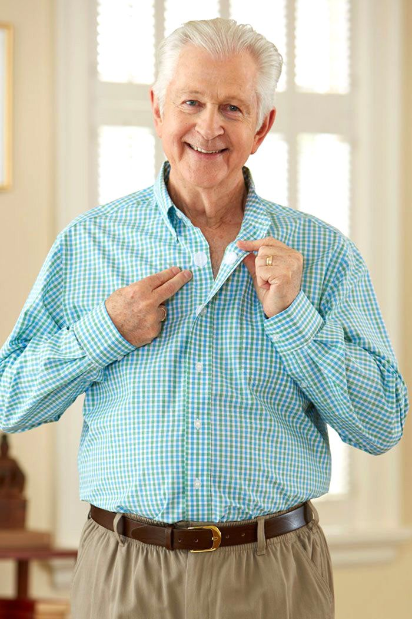
Clothing for People with Limited Dexterity
Children, elders and people with physical disabilities
Fingers and arm movement effect dressing
Velcro and magnets
Assistive devices for easy on/off shoes and jewelry
Buck & Buck

Slide 35
Clothing for People with Access Needs
Access to arms, necks, chest, and other parts of bodies may be necessary for ports and intravenous medications and treatments, either constantly or periodically.
Sleeves and pants with openings for easy access
Toileting considerations
Slick Chicks

Slide 36
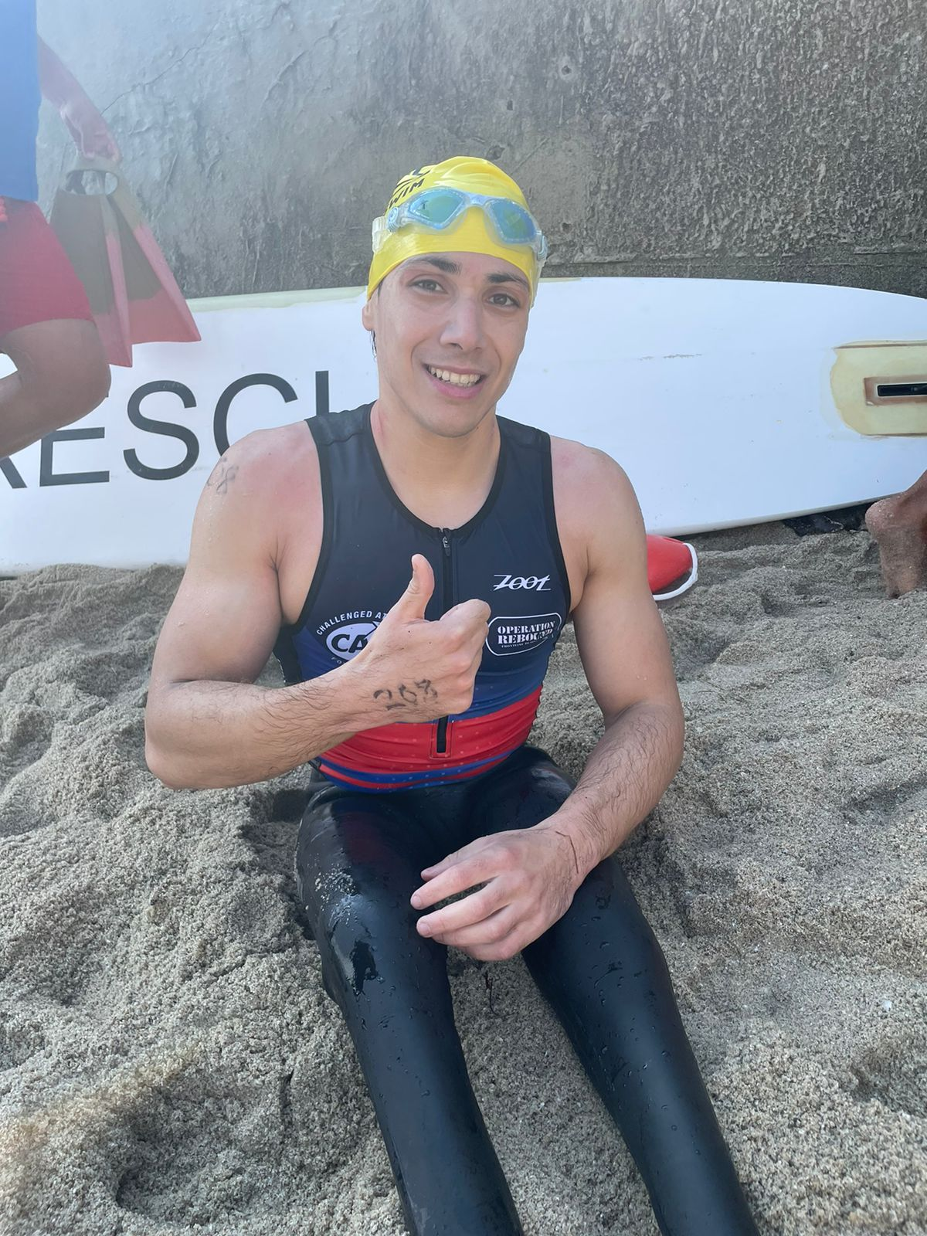
Amputees, Braces, and Varied Bone Structure
Considerations in Design
minimize attention and blend in
broader pant legs or sleeves
Easy on/off access
design and fitting and may be challenging for mass market applications.
Francisco Postlethwaite Munoz Competitive triathlete

Slide 37
Clothing for Visually Impaired and/or Blind
Considerations in design
Limited or no ability to see
Colors
labeling and care instructions
Braille
Shopping considerations
LACHI blind music artist
Asthma stole – Adaptive by Asiya

Slide 38
Developmental Disabilities
Considerations in Design
Desire for independence
Ease of dressing and undressing
Ease of fasteners
Soft, smooth textures in fabric
Colors, weight of fabrics
Sound sensitivity
Myself Belts

Slide 39
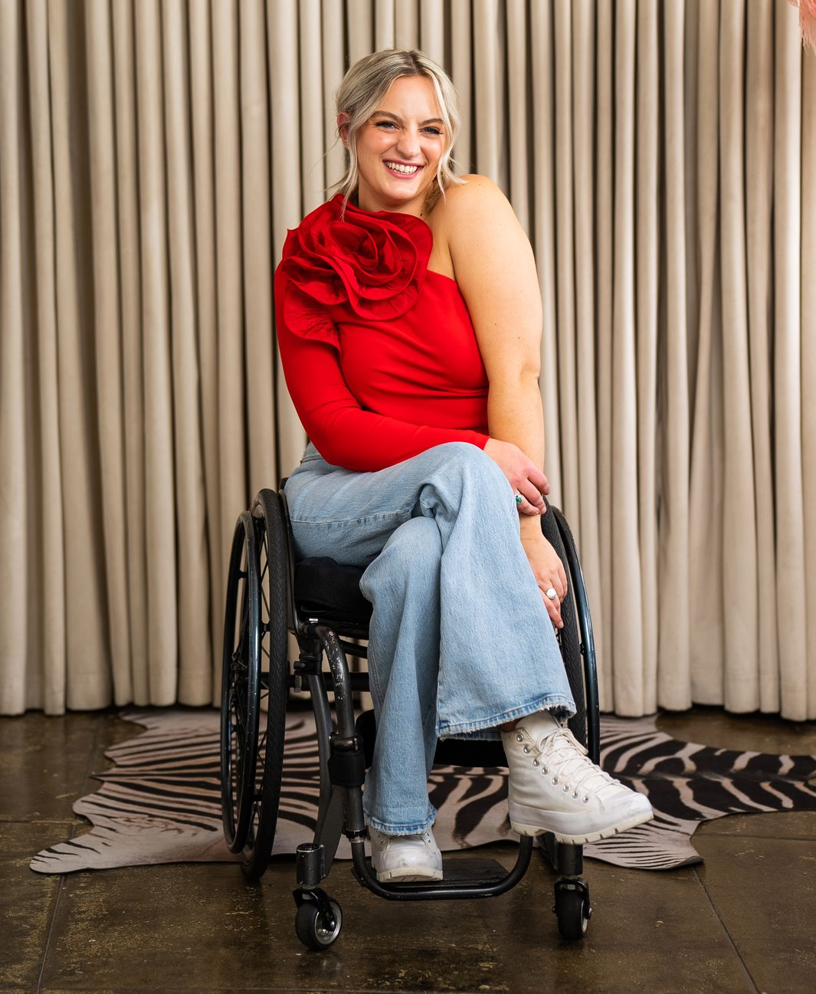
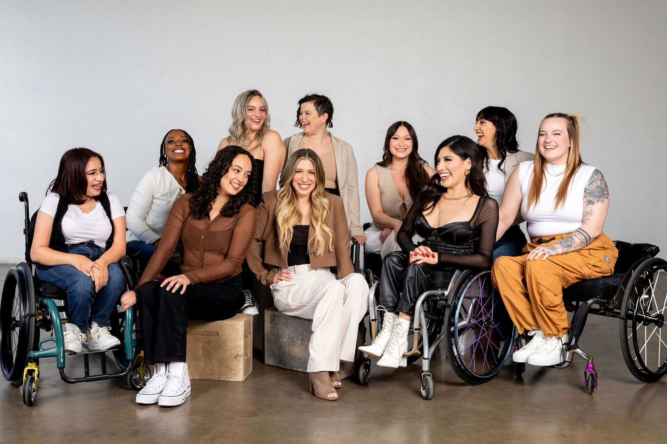
ROLLETTES
Wheelchair
Athlete
Dance
Empowerment
Creativity
Community
Fundraising
Performance
Physical fitness
Beauty
Fashion
Conner Lundis
Marketing Director
Team Rollettes

Slide 40
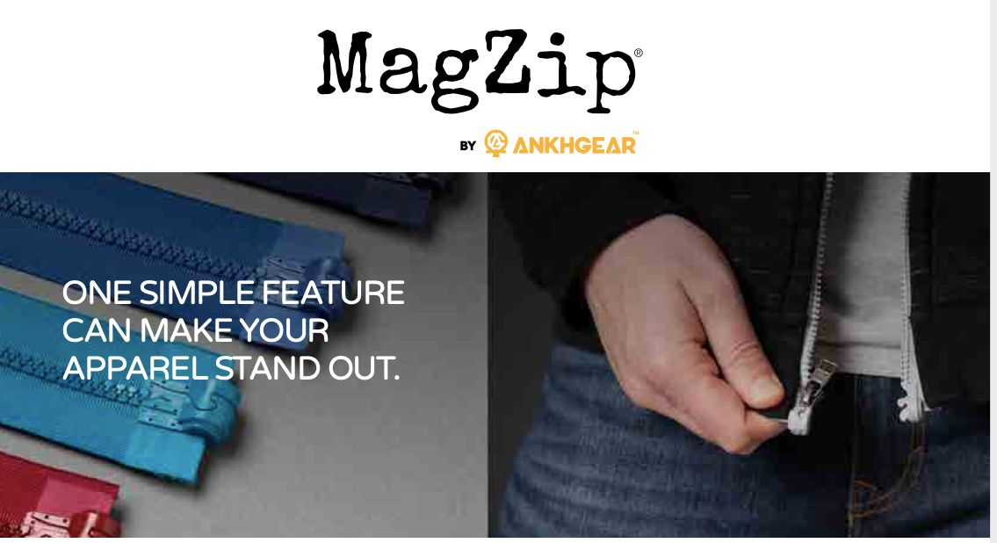
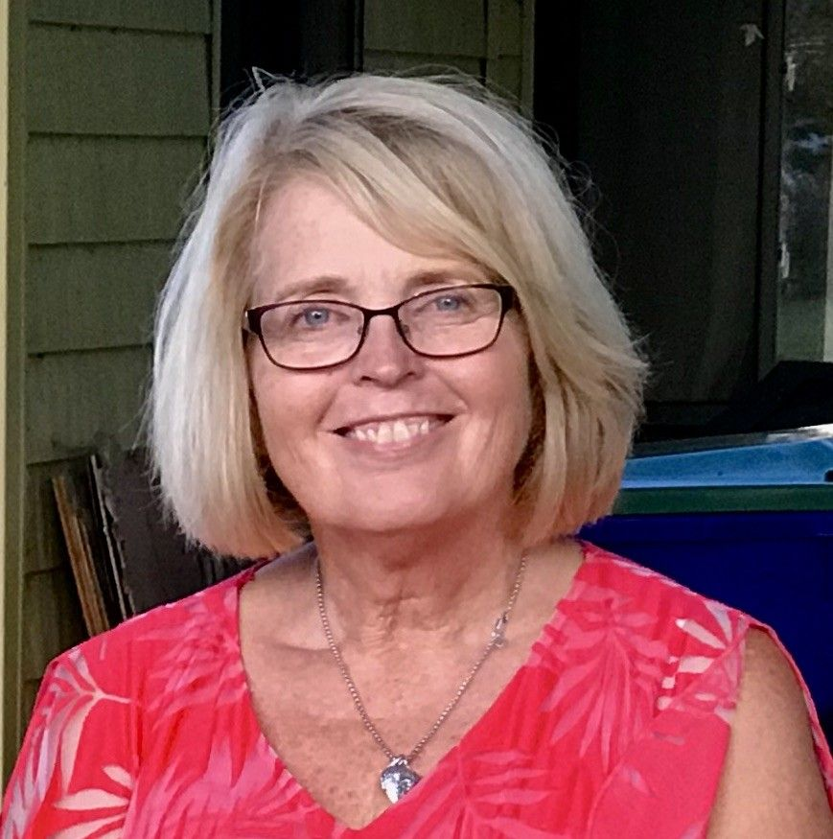
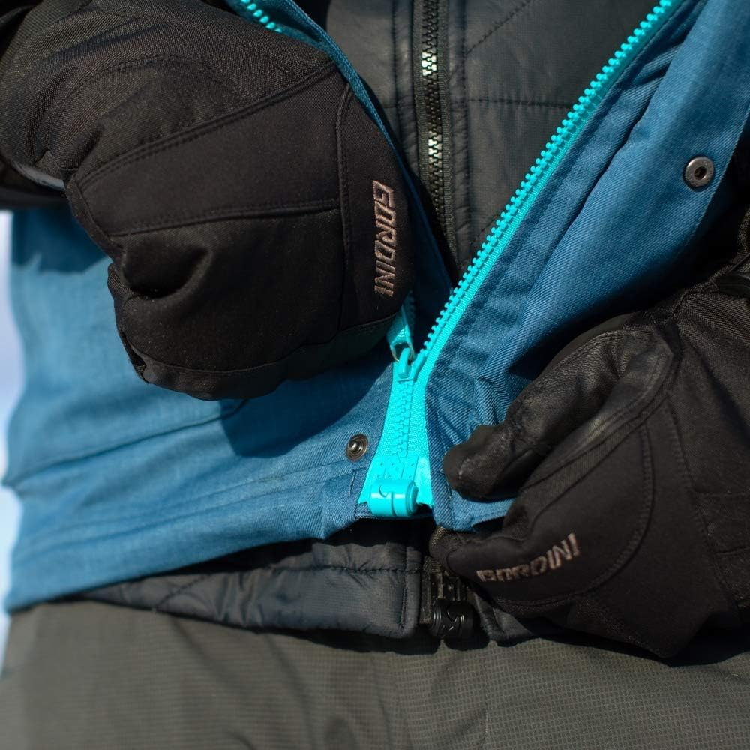
MAGZIP-ANKHGEAR
Magnetic
Innovation
Research
Design
Quality
Technology
Simplicity
Nancy Peters OTR/L

Slide 41
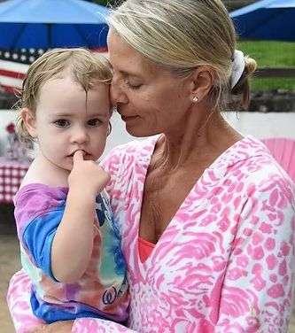
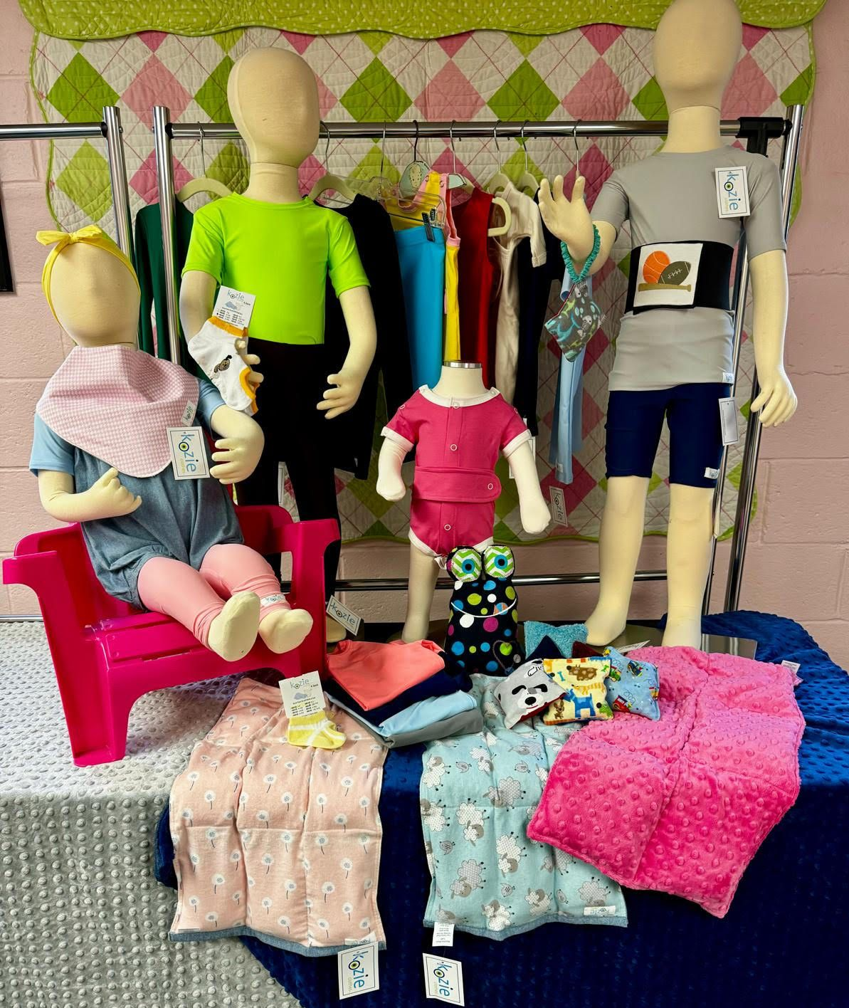
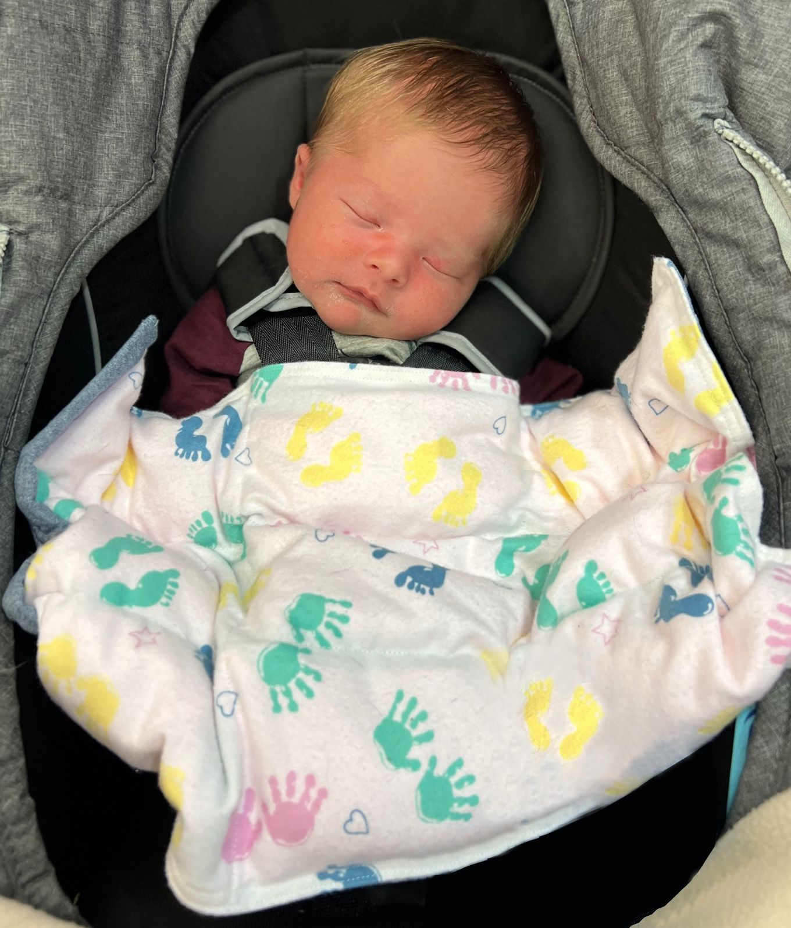
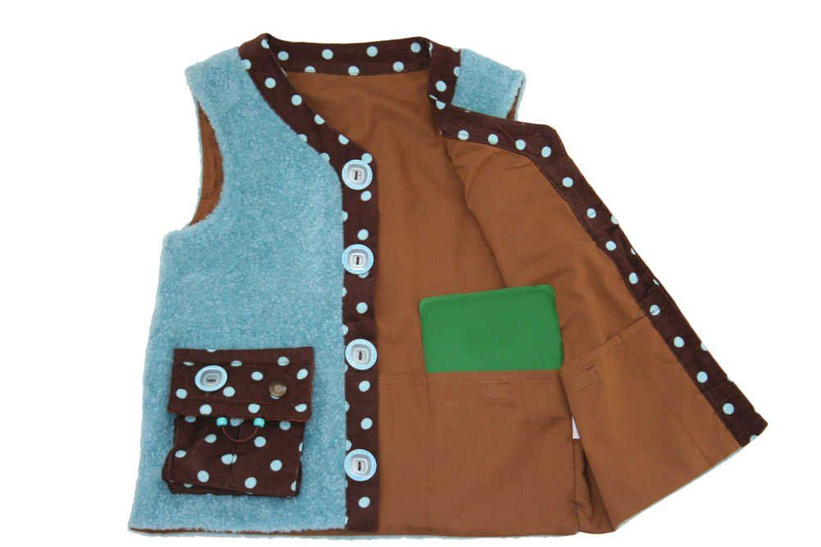
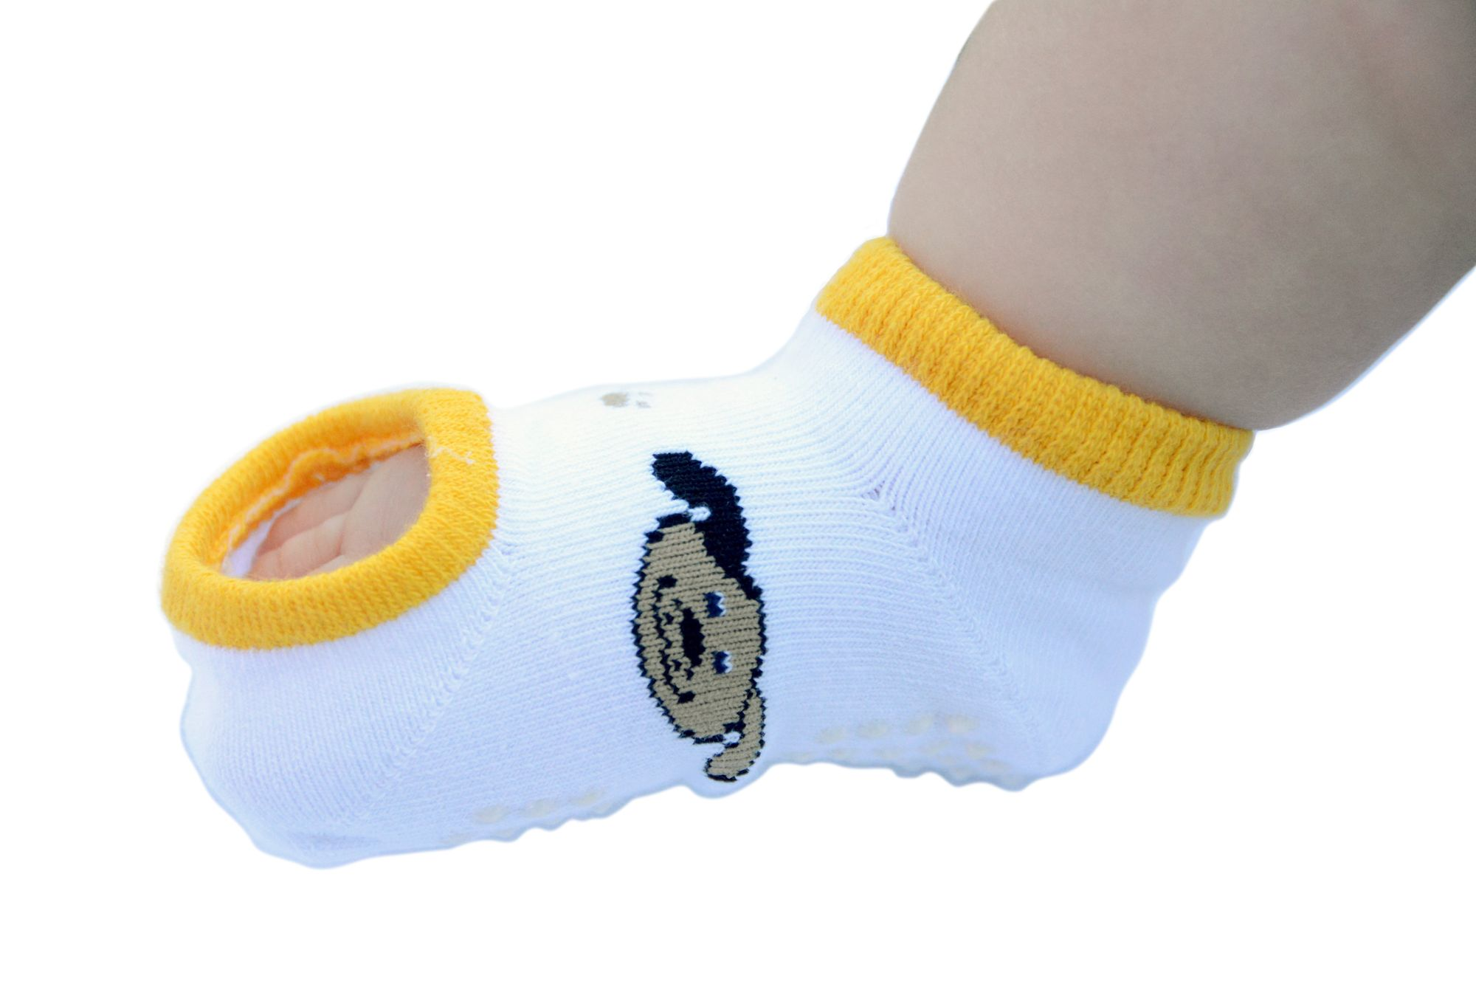
KOZIE CLOTHES
Sensory
Children/Infants
Compression
Ease of care
Weighted
Design
Customer Service
Innovation
Susan Donohoe Founder

Slide 42
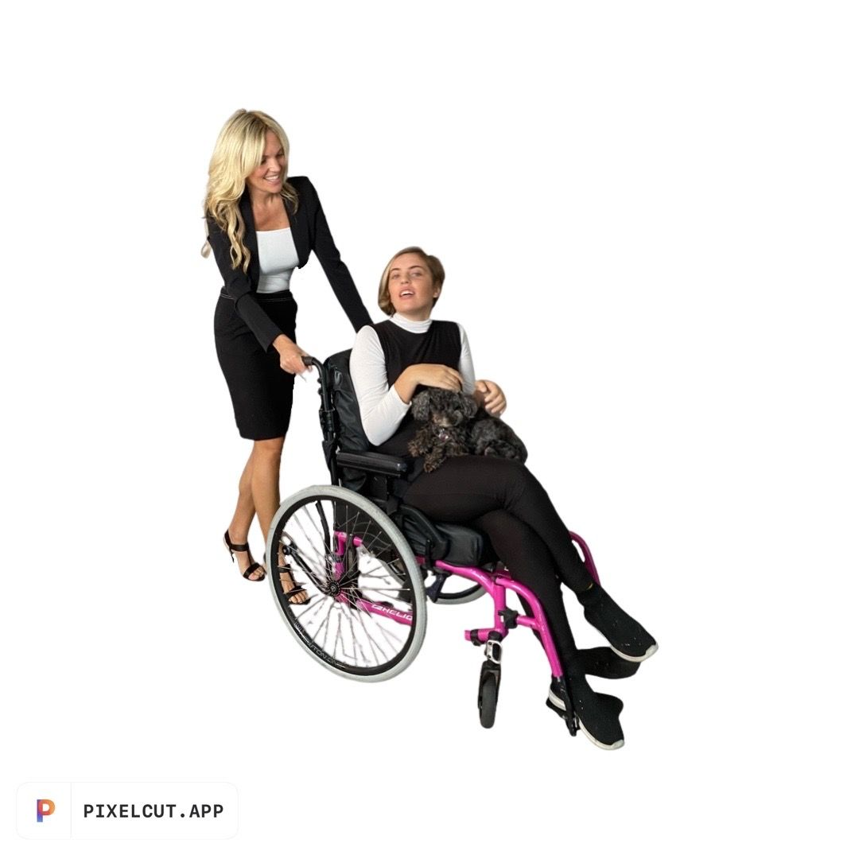
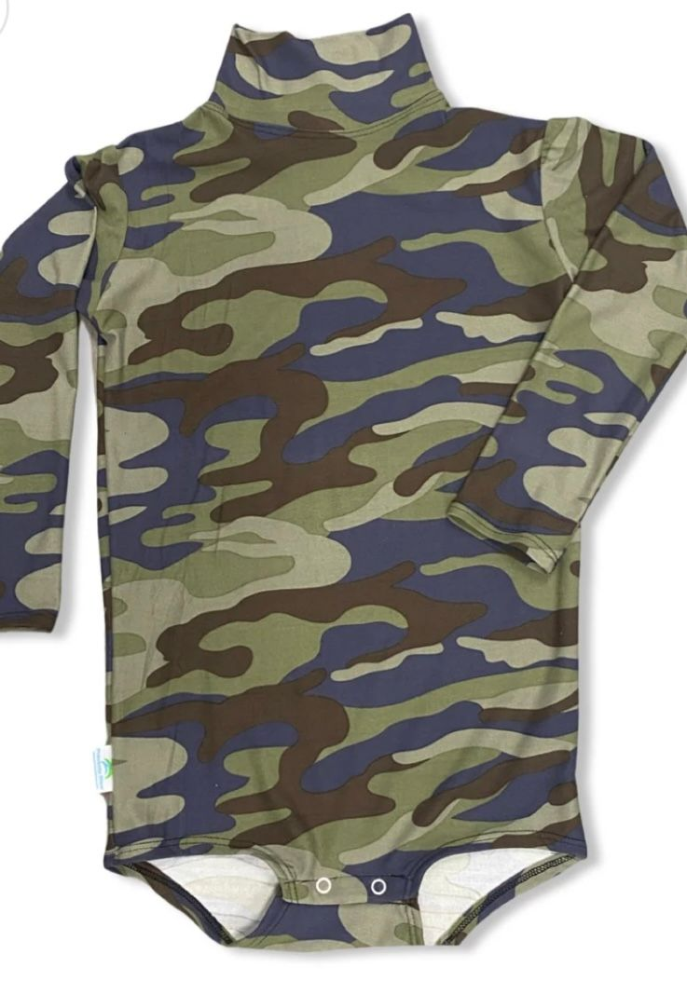
PREVENTAWEAR
Body suits
Waterproof
Incontinence
Special needs
Customer service
Onesies
Furniture protectors
Waterproof spray
Design
Technology
Cindi Seifert Founder/CEO

Slide 43
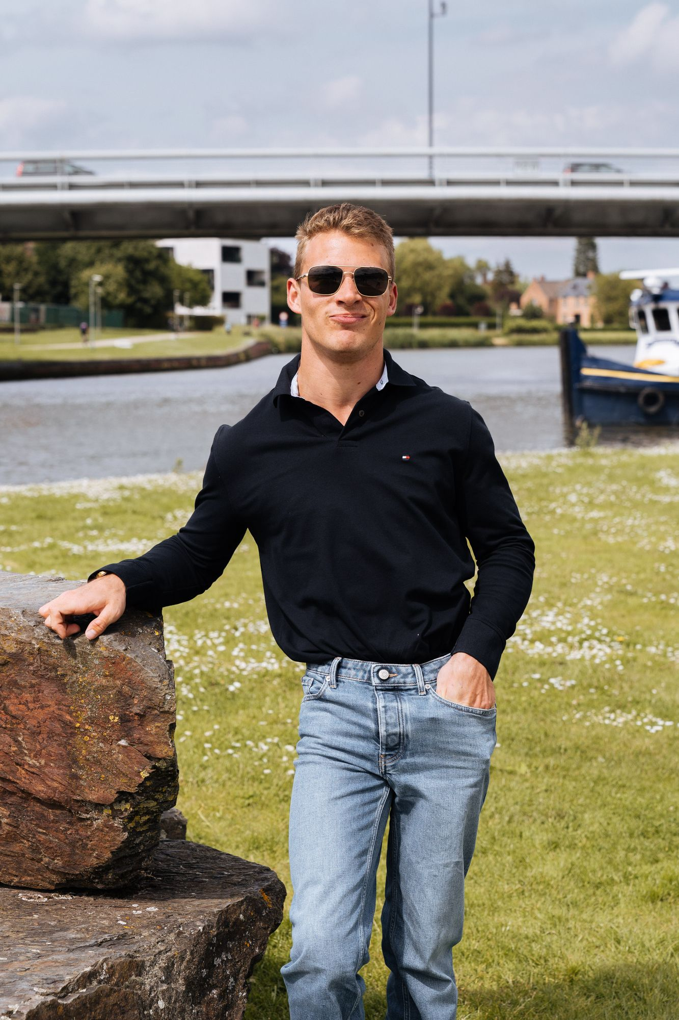
Module 5 Self Image and Disability
Maslow's Hierarchy
Esteem and disability
Ableism
Costumes
Swimwear
SO YES

Slide 44
Maslow's Hierarchy of Needs
Physiological
Safety
Love / Belonging
Esteem
Self-Actualization

Slide 45
Esteem and Disability
Childhood
Adolescence
Maturity
Older age
Abilitee

Slide 46
Cultural Ableism
Ableism exists when there is a negative prejudice towards people with disability
Stephanie Thomas Cur8able
It suggests that people with disabilities are less competent due to their disabling condition, and that there is no way that they can live meaningful, productive lives without being a burden on society.
When ableism dominates, people with disabilities feel rejected, as though they are a burden to society. They are fearful of being judged when speaking up for what they need and deserve and simply accept society’s conditions.

Slide 47
Costumes and Esteem
Opportunity for fantasy
Effects on self esteem
Restrictions in schools
Considerations in characters
Halloween, dress up parties, make-believe
Adults and children
Kozie compression

Slide 48
Swimwear and Self-Image
Swimwear exposes everything
Considerations in Design
Body shapes
Sizes
Dexterity
Toileting
Easy access
Mental health
Anxiety
Depression
MIGA Swim

Slide 49
MANIKIN
One Hand Sewing Man
Erbs Palsy
Quality
Glamour
Empowerment
Inspiration
Confidence
Branding
Next in Fashion
Qaysean Williams
Fashion and costume designer

Slide 50
MIGA SWIM
Made in USA
Sustainability
Swimwear
Community
Body Image
Poly-bags
Longevity
Inclusion
Equality
Disfigurement
Maria-Lousia Mendiola
Founder / CEO

Slide 51
Module 6 Inspiring Confidence, Communication and Connection: Apparel for Enhancing Self Esteem
Self-Image
Global awareness
Social media
Health and fitness
Universal design
Paralympics
Competitive athlete Francisco Postlethwaite

Slide 52
ABILITEE
Advocacy
Sustainability
Community
Inclusive
Functional
Ethical
Sustainable
Chronic illness
Ostomy
CEO/Founder
Marta Elena Cortez-Neavel

Slide 53
ALTER UR EGO
Wheelchair
Fashion
Function
Jeans
Kick starter
Heidi McKenzie Founder/CEO

Slide 54
PLAE FOOTWEAR
Universal Design
Technology
Culture
Change
Re-sale
Sustainability
Customization
Craft
Ryan Ringholz - Founder

Slide 55
Module 7 Fashioning the Social World of Disability
Social model
Industry challenge
Three A's
Costs
Three nations policies
Slick Chicks

Slide 56
Social Model & Disability
Disability v Impairment
Fitting in
The industry challenge
P
DEWEY Clothing

Slide 57
SEWN ADAPTIVE
Custom tailoring
Customer service
Adaptive alterations
Virtual fittings
Innovation
Accessibility
Sewing patterns
Wardrobe styling
Costume design
Lynn Brannelly & Alexander Andronescu

Slide 58
MYSELF BELTS
Independence
Physical & Cognitive
Shark tank
Entrepreneur
Fashion
Function
Rehabilitation
Patent
Marketing
Talia Goldfarb Founder / Co-owner

Slide 59
The Three A's
Adaptable
Accessible
Affordable
So Yes

Slide 60
Costs
Government Assistance and Insurance
Government Programs
United States
Australia
Canada

Slide 61
SO YES
Comfort
Style
Independence
Quality
Design
Magnetic zipper
Elastic
Customer service
Marketing
Affordable
User experience
Founders
Jessie Provoost & Sofie Ternest

Slide 62
LIBERARE
Independence
Entrepreneur
Women inclusive
Easy on/off bra
HeroHold TM
Innovation
Research
Brown University Alumna
Emma Butler
Founder/CEO Liberare

Slide 63
Module 8 Essential Considerations in Marketing
Business model
Communication
TRACOM SOCIAL STYLE tm
Disability market
FFORA

Slide 64
TRACOM SOCIAL STYLE tm
Driving
Expressive
Amiable
Analytical

Slide 65
Adaptive Vocabulary
Ableism
Accessible
Adaptive apparel
Adaptive clothing
Adaptive fashion
Adaptive space
Adaptivewear
Dexterity
Disability
Ease of dressing
Functional
Impairment
Inclusive
Magnet
Paralympics
Runway of Dreams
Social model
Universal Design
VA clothing allowance
Velcro
Wheelchair

Slide 66
CUR8ABLE
Disability Fashion Styling System
Disability fashion stylist
TEDx speaker
Congenital amputee
On-air personality
Voice actor
Autor
BTB strategist
Blogger
Policy maker
Disability advocate
Educator
Yoga enthusiast
Stephanie Thomas
Founder/CEO Cur8able

Slide 67
BILLY FOOTWEAR
Inclusive
Easy on/off
Universal Design
Function
Innovation
Kickstarter
Podcasts
Problem Solving
Design
Zippers
Technology
Billy Price
Co-founder

Slide 68
Key Financial Reports
Income statement
Balance sheet
Inventory report
Break-even analysis
Ratio's

Slide 69
Unit 9 Supplementary Information
Public figures
Activists
Education
Santa Monica College
Student drawings

Slide 70
PUBLIC FIGURES
Athletes
Actors
Models
Politicians
Musicians
Artists
Business leaders
Medical
Marketing
Lauren Wasser
Girl with the Golden Legs
Qaysean Williams
One Hand Sewing Man

Slide 71
ACTIVIST Adaptive by Asiya
International community
Modest fashion design
Social change
Music
Textile sourcing
Research
Imagination
Charity
Entrepreneur
Disability activist
High performance
Drum therapy
Photo by Yuliia
Jessica Smith
paralympian swimmer
Jad Ahammad
Al Zaid Arts photo-Marwa Hamad
Asiya Rafiq designer

Slide 72
Vollbrecht Consulting
Business as educators
Education programs
Adaptive consulting
Universal fashion
Inclusion
Global
Industry leader
Functional
Fashion
Design
Value
Branding
Educational services
Tracy Vollbrecht
Founder/consultant
Vollbrecht Consulting

Slide 73
Disability is a beautiful place where a fashion seed is growing

Slide 74
Adaptivewear Business Plan
Executive Summary
Company History
Market Analysis
Products & Services
Strategy & Implementation
Sustainability
Website
Key Financial Reports
Reflection

Slide 75
Executive Summary
Goals & Objectives
3 A's of Universal Design & Adaptivewear
Disability sensitive
Considerations in diversity, inclusivity, accessibility, costing & design
Mission & Vision
Image & Positioning

Slide 76
Company History
Experiences that have prompted interest in advancement of adaptive clothing
Inspiration for the adaptive mission
Relevant research/history as applicable to disability and design
Benchmark comparison

Slide 77
Market Analysis
analysis of the quantitative and qualitative consumer disability market segment
apparel industry textile and production resources as they relate to disability design and manufacturing
Competition in adaptivewear
legal considerations in design, marketing and customer service
Diagrams and graphs representing the market and highlighting opportunities
Trends in adaptivewear

Slide 78
Products and Services
Sketches, designs, and samples
cost and spec sheets that clearly outline inventory investment
are essential elements in the development of plans 15 for design and production.
Related technology, fabric considerations, 16 and textile development should accompany these, and the role and ac17 cessibility of customer service,
the location of leased / franchise de18 partments, and consultants should also be included

Slide 79
Strategy and Implementation
Marketing goals with sensitivity to diversity, sustainability, budgeting and accessibility as it applies to the disability consumer
Advertising and promotion
Collaborations with people with disabilities
Disability trade shows and publications
Medical industry as a resource
Social media platforms that support disability advocacy
Schools and workplace applications
Adaptivewear paradigm shift
Financial goals reflective of the disability consumer market spending
Adaptivewear product life cycle
Considerations in retail pricing as it relates to disposable income
Loyalty programs

Slide 80
Sustainability Plan
Environmental awareness
Labor standards
Recycling/upcycling
Technology
ADA laws
Ethical Standards in business activities
Philanthropy

Slide 81
Website
Disability awareness vocabulary
Accessibility
User friendly
Adjustable font size
Omni-channel formats
Verbal descriptions and access
Considerations in format

Slide 82
Control
6 Month buying Plan
Risk Management
Sales Reports
Shortage/Overage
Mark-downs
COGS

